Slide 1
2013 Legislative Summit
Bruce Bullock
Director, Maguire Energy Institute
Adjunct Lecturer
Business Strategy and Economics
Notes:
Good morning and welcome.
I am Bruce Bullock, Director of the Maguire Energy Institute.
I am glad you’re here.
I want to take you through the new energy curriculum, the course, and the syllabus this morning, and then I want to learn a little more about you.

Slide 2
Petroleum Supply Chain

Slide 3
What has changed the game?
George Mitchell
Reasonable public policy
3D and 4D Seismic
Deepwater technology
Horizontal drilling
Hydraulic fracturing

Slide 4
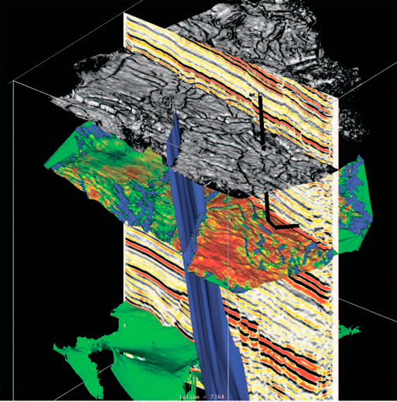
3D Seismic

Slide 5
Deepwater Technology

Slide 6
Horizontal Drilling and Hydraulic Fracturing

Slide 7
Barnett Shale Well Count
16,530

Slide 8
Barnett Shale Gas Production

Slide 9
Eagle Ford Drilling Permits

Slide 10
Eagle Ford Gas Production

Slide 11
Eagle Ford Oil Production

Slide 12
Eagle Ford Condensate Production

Slide 13
Permian Basin Drilling Permits

Slide 14
Permian Basin Production

Slide 15
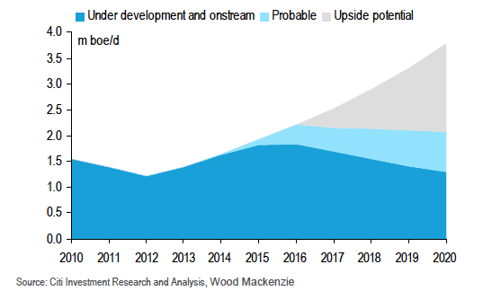
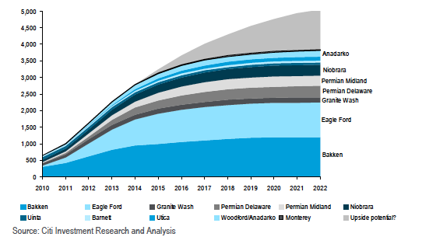
Eagle Ford and GOM Future Could Be Bright

Slide 16
Constraints
People
Policy
Infrastructure
Midstream

Slide 17
Trends in the Refining and Marketing Value Chain

Slide 18
Trends
Divestment of retail operations
Refining margins squeezed
Splitting of integrated companies
Ethylene expansions on the Gulf Coast

Slide 19
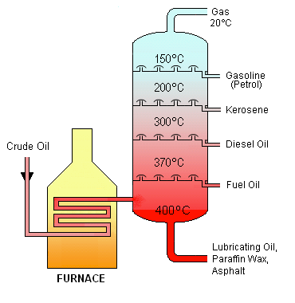
Refining 101
Distillation is used to separate the various elements of crude oil into its separate components
Crude is boiled, and the vapor condenses in a tall distillation column
Different components are drawn off as they condense at each level
The heavy bottom fractions are often cracked into lighter, more useful products
All fractions are processed further in other refining units

Slide 20
Divestment of Retail Operations
ExxonMobil divested retail stations
7-11 expanding
Quik Trip and other super stations growing

Slide 21
Squeezed Refining Margins

Slide 22
Integrated Companies Splitting

Slide 23
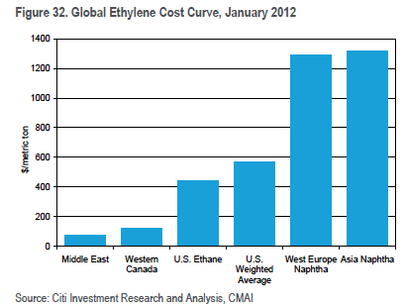
Low Energy Costs Driving Petrochemicals

Slide 24
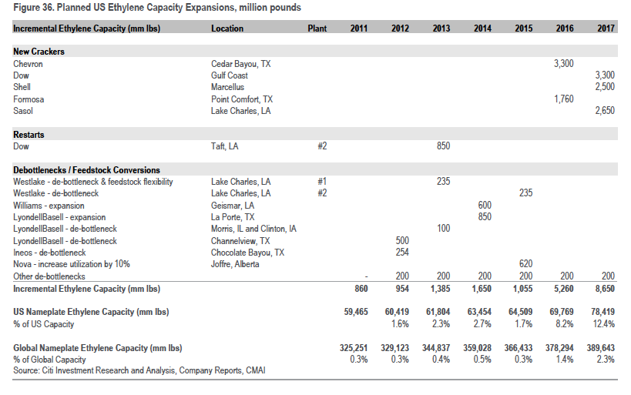
Great News for Texas

Slide 25
Constraints
Capital costs
Heavy crude supply
Environmental restrictions

