Slide 1
Opportunities for 2013
Natural Gas Vehicles and Continued Progress on the Texas Triangle
February 4, 2013
Lynn Lyon – Director of Fuel Marketing

Slide 2
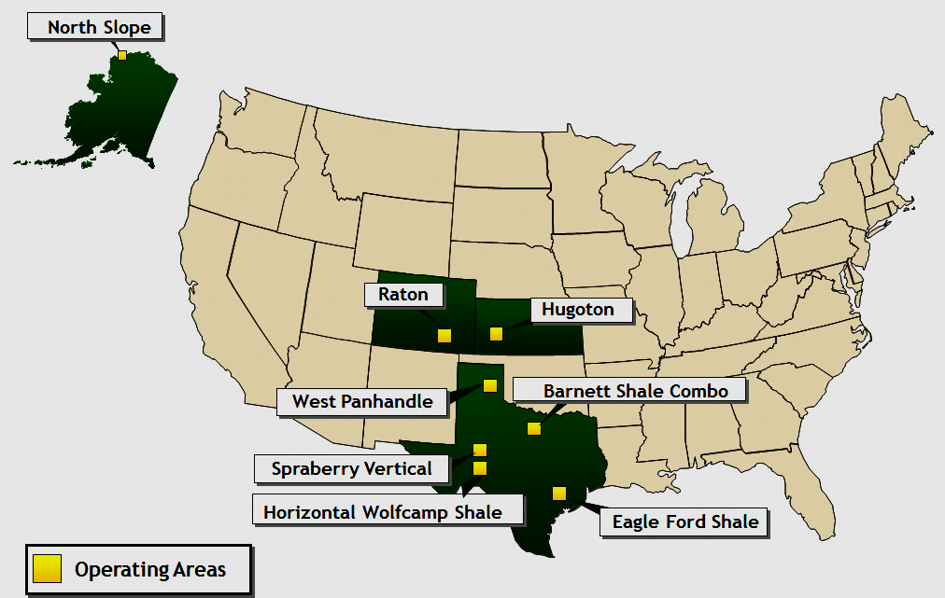
Pioneer Natural Resources
Top Tier Oil & Gas Producer - $15B Market Cap
Leading Driller in Texas
Fortune 500 company, Included in S&P 500 Index
Active ANGA Member & Champion for Increasing Natural Gas Market

Slide 3
Opportunities for 2013
Lead By Example Using TX Natural Resources
Manage Transportation Changes with Programs and Regulators
Push for Unprecedented Results
  More Natural Gas Powered Vehicles
  More Natural Gas Powered Off Road Engines
  Decreased Emissions
  Strong Economic Impact for TX
Notes:
Thank you to

Slide 4
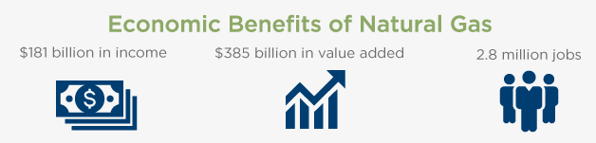
An Economic Engine for Texas
Natural Gas Working for Texas
$60 billion $133 billion 1.3
Data Source: http://www.anga.us/media/232348/texas%20economy.pdf
Notes:
The top of the graphic shows the total US with the bottom portion representing TX’s contribution.

Slide 5
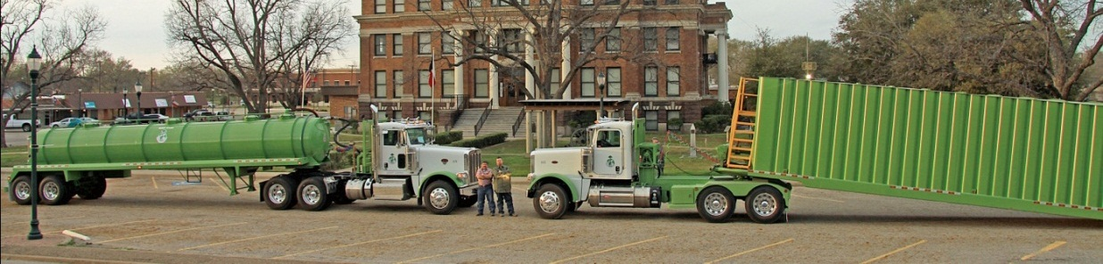
Domestic & Abundant
  98 % of the natural gas we use in this country comes from right here in North America
  Why import more than 10 million barrels of oil each day?
  Greater reliance on our own vast domestic supplies of clean natural gas can advance our national security
  Using natural gas for transportation can make a real difference
Green Energy Oilfield Services, Fairfield, Texas
Replacing 3.5MM heavy-duty vehicles with natural gas vehicles by 2035 would save >1.2MM barrels of oil per day-more than the U.S. imported from either Venezuela or Saudi Arabia in 2009

Slide 6
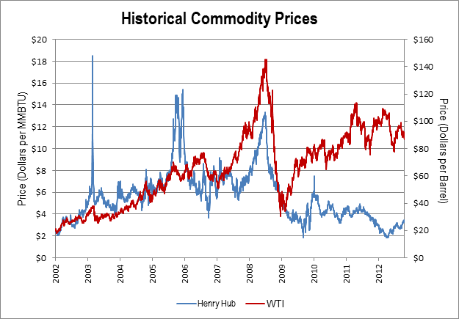
Lower Prices

Slide 7
CNG Pricing
NYMEX Spot $1.89/MM Btu
NYMEX Spot $5.00/MM Btu
Notes:
If the spot price for natural gas increases 2.5X, it has a minimal impact on the price
at the pump. If the price of oil increases 2.5X…

Slide 8
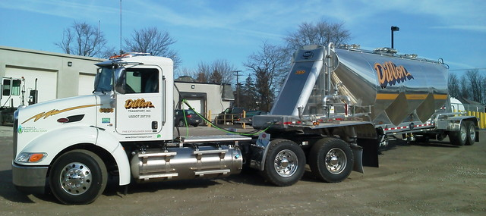
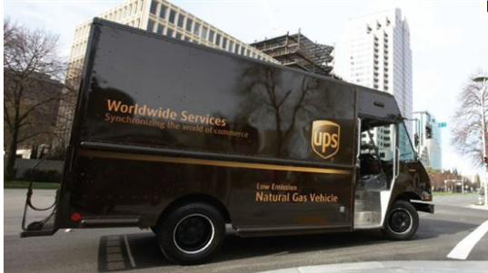
Texas Clean Transportation Triangle
Estimated Project Benefits
Benefits | 10 Years
GHG Emission Reductions | 95,410 MT
PM Emission Reductions | 71.50 tons
NOx Emission Reductions | 3,440 tons
Diesel Fuel Displaced | 41,286,530 Gallons
Natural Gas Demand | 6,232,233,150 SCF
2012 Honda Civic Green Car of the Year

Slide 9
TX Clean Transportation Triangle – How It Started
State Affairs Committee
NGV Committee
Legislative Effort
Trucks & Stations
ANGA Formed
TCTT Analysis
Law Passed
TCEQ Program
2009
2009
2010
2011
2011
2011
2012-14
2014
RESULTS | NOMINAL PLAN 2 Years | GROWTH 10 Years
Trucks Deployed in Place of Diesel | 550 | 5000
Annual Diesel Fuel Displaced (Gallons ) | 4 MM | 38 MM
Annual Natural Gas Fuel Demand | 0.6 Bcf | 6 Bcf

Slide 10
Unprecedented Planned Growth in Texas
Leading the Nation
  >300% more LNG Stations - 23 new stations `$46MM investment in TX
  >100% more CNG Stations – 39 new stations `$29MM investment in TX
Increased Competition PLANNED with Fuel Stations
  Top station provider Clean Energy Stations
  New providers - Valero, Shell, Love’s, Stripes, Texaco, CPS Energy, TX Gas Services, Zeit Energy, McShan Florist, 7-11/Tetco (locations TBD), Ryder
Increased PLANNED Fleet
  Frito-Lay, 7-11, DART, Waste Management, Ryder, Atmos, UPS, Clean Harbors, FedEx, Sysco, US Foods, Central Freight Line, Cities of Temple, Laredo, El Paso, Dallas
  >$23MM requested oversubscribing $19MM TX Natural Gas Vehicle Grant Program
Notes:
TX to have 2nd largest LNG infrastructure after California California has more stations currently with 38 existing but are only adding 8
DART – 460 New Buses, 200 Paratransit Vehicles– 100% of bus fleet to run on CNG
DFW Airport - >500 CNG maintenance vehicles, 95% run on CNG
Oil and Gas Service Companies - Green Energy Oilfield Services and Dillon Transport
Waste Management –to convert 100% of fleet to CNG, HQ in TX >18,342 trucks
Sysco –to convert 100% of fleet to LNG/CNG, HQ in TX, largest private truck fleet in North America >9,000 trucks has >215 LNG powered trucks in CA.
Pepsi/Frito-Lay – After successful pilot project, 67 trucks purchased, deployment includes Irving.
Central Freight - HQ in TX has >5,000 trucks investing in CNG Tractors. 15 trucks in TX. Partners with Swift Transport interested in converting trucks.
Ryder – Approved for station grant for Grand Prairie facility, working on TX program.
UPS – Opening LCNG stations in all points of TCTT with `200 trucks at each point.
FedEx – Purchased first LNG trucks for their Dallas-based fleet.
Atmos – Purchasing more NGVs, providing land for Arlington station.

Slide 11
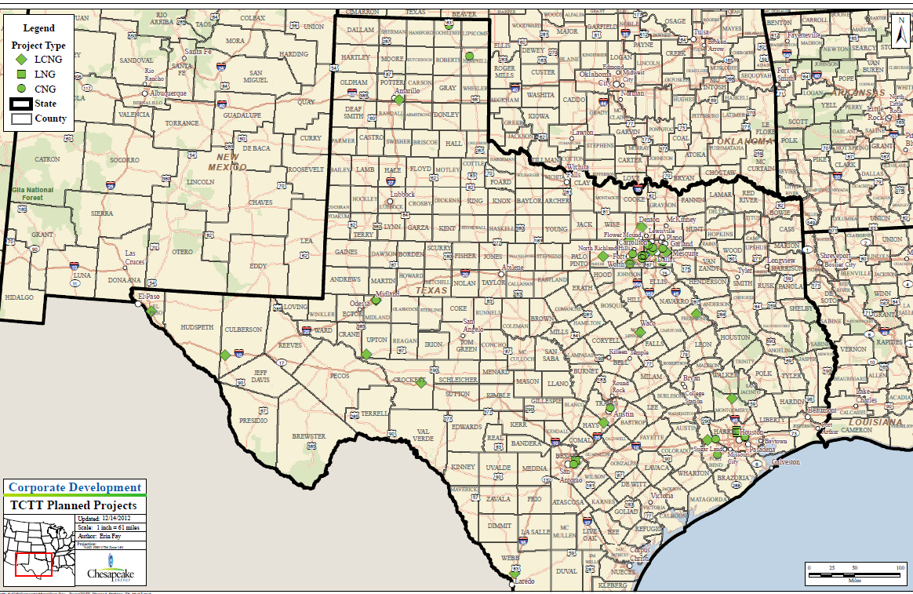
62 New Stations Planned (81 Existing)
Sources – http://www.afdc.energy.gov/fuels/natural_gas_locations.html
http://www.tceq.texas.gov/assets/public/implementation/air/terp/ctt/CTT_FY12_ApplicationsSelected.pdf
http://www.tceq.texas.gov/assets/public/implementation/air/terp/affp/2012affp_selections.pdf
http://www.cleanenergyfuels.com/pdf/CE-OS.ANGH.012412.pdf

Slide 12
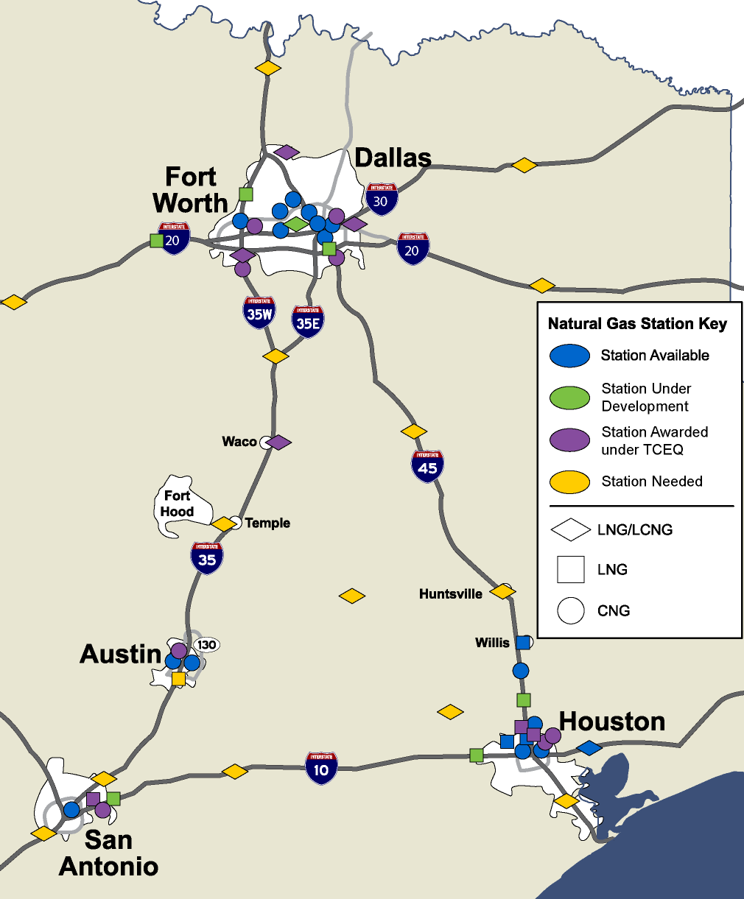
Next Steps:
Ensure Phase 1 plans become reality
  Achieve project contracts and gas demand results.
  Fleets planning for 2013 purchases now, need help analyzing TX grant options
Identify Phase 2 stations
  Close remaining gaps
  Fill in fueling along internal, non-interstate highway CTT roads
  Stations on highways heading out of the Triangle
  Plan Phase 3: Beyond the Triangle
  Connect West to El Paso, East to Haynesville Shale, North to OKC (and onward to Canada), South through Laredo (and onward to Mexico City)
  I-10 Connectivity from Houston to Los Angeles and Houston to Atlanta
Notes:
Consortiums – N TX, Houston, San Antonio, E TX
City, County and State Business Development Leaders
Fleets – The Trucking Industry provides >$223B annually in TX
Natural Gas Producers – Texas #1 Producer of Natural Gas
Vehicle Conversion Companies
Station Equipment Manufacturers
Auto Manufacturers
Academic Institutions
Policy Makers & Administrators
Non-profit Organizations
Entrepreneurs

Slide 13
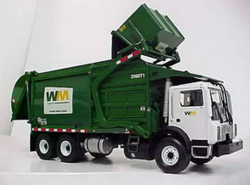
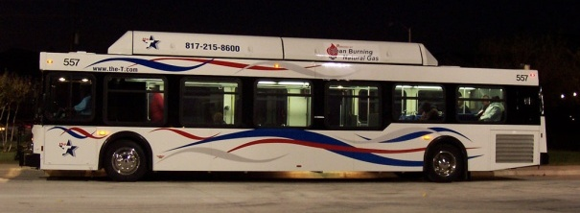
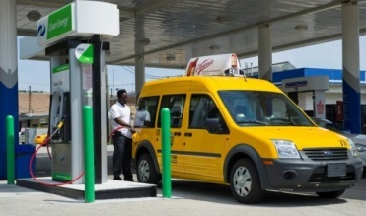
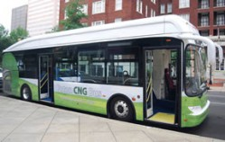
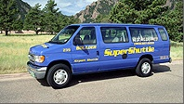
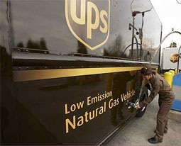
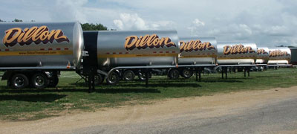
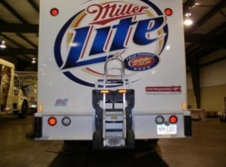
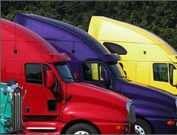
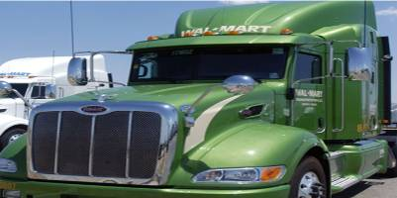
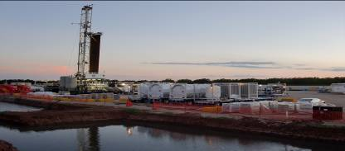
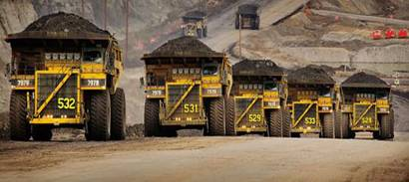

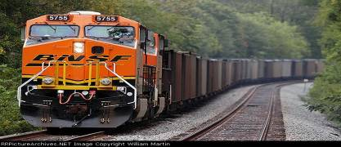
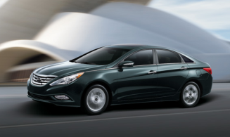
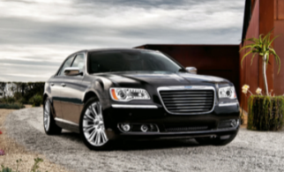

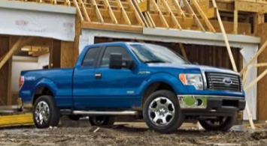
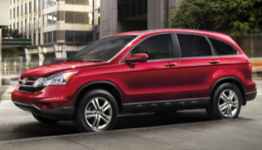

The Natural Gas Fueling Opportunity
Medium to Heavy Duty | Refuse, Public Transit, & Ports | 4 Bcf/D
Heavy Duty On-Road | Heavy Duty Trucks | 13 Bcf/D
Heavy Duty Off-Road | Mining, Marine, Rail & Construction | 16 Bcf/D
Light Duty Mass Market | 6X6 Vehicle Platform & Home Refueling | 57 Bcf/D
Current U.S. Demand = 66 Bcf/D
Additional U.S. Demand = 90 Bcf/D
Notes:
90 Bcf/D = 100% of the fuel market for each segment, understanding a subset of each market would move the needle for gas consumption in the US
Light Duty Mass Markets represent the voice of the North American public - requires approach through Bi-Fuel CNG hybrid platforms
Heavy Duty Off-Road LNG has strong economics - market is “led by” Natural Gas Operations enabling Mining, Marine, Rail & Construction feasibility
Heavy Duty On-Road provides national “connect the dots” visibility - market is “growing” as Class 8 tractor product selection expands in 2012-2014
Medium to Heavy Duty includes refuse, public transit, and ports - maturing market, governmental mandates & incentives are working, Transit buses now account for about 62% of all vehicular natural gas use.

Slide 14
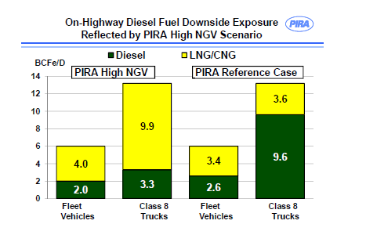
Critical Threshold
Notes:
Even reference case is a significant increase and changes the transportation environment with the addition of 3.6 million NGVs by 2032

Slide 15
Bold 10 Year TX NGV & Demand Growth Goals
 | 2012 (actual 2-year growth) | Annual Growth Goal | 2022 Target (total) | Target Groups
Light-Duty | 1,565 | 4,000 | 40,000 | E&P, upstream supply chain, other gas industry, taxi, government, consumer
Medium-Duty | 6 | 2,000 | 20,000 | 25% of state and public fleet, utility, E&P, commercial
Heavy-Duty | 1,361 | 4,000 | 40,000 | Commercial trucking, transit, refuse, public, E&P supply chain

Slide 16
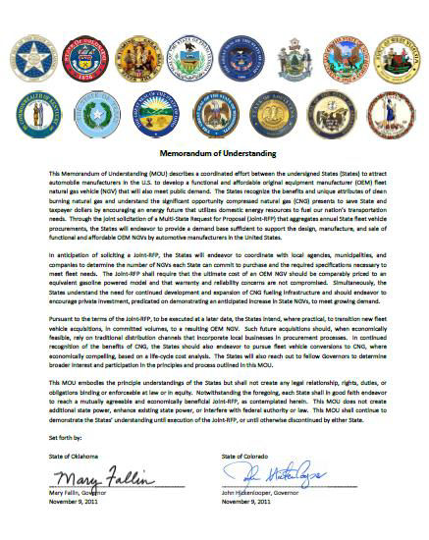
Governors’ Memorandum Of Understanding for Natural Gas Vehicles
22 States Participating
Aggregates state vehicle procurement in a Joint RFP; utilize local distribution networks
Engage local government in procurement to the extent practicable
OEM NGV should have comparable performance and price to a gasoline vehicle
Encourage private investment in NGV infrastructure
Reach out to fellow Governors to encourage participation

Slide 17
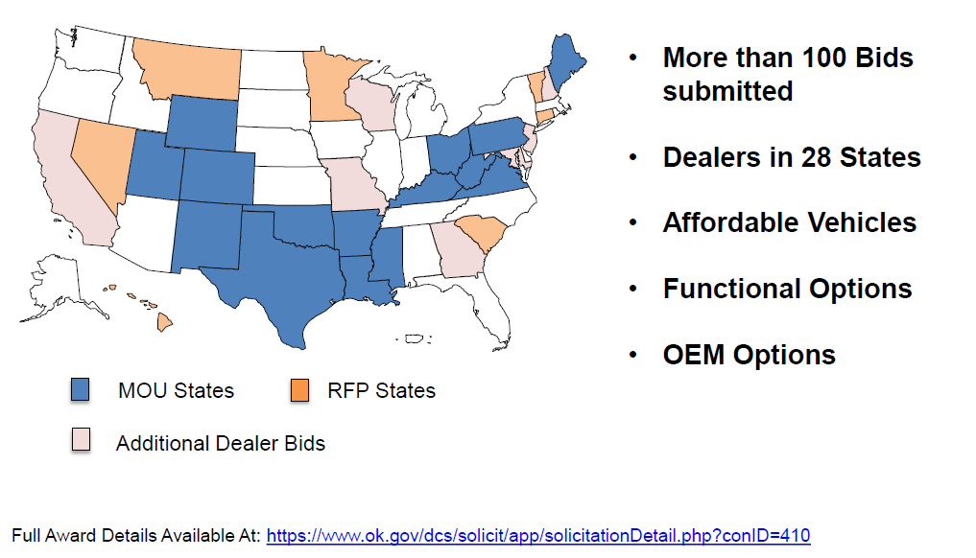
Award Details & Next Steps
40,000 Texas fleet vehicles – OK and CO combined have 30,000
Detailed inventory with type of vehicle, mileage & replacement schedule
Review near-term opportunities for pick-up and van replacements

Slide 18
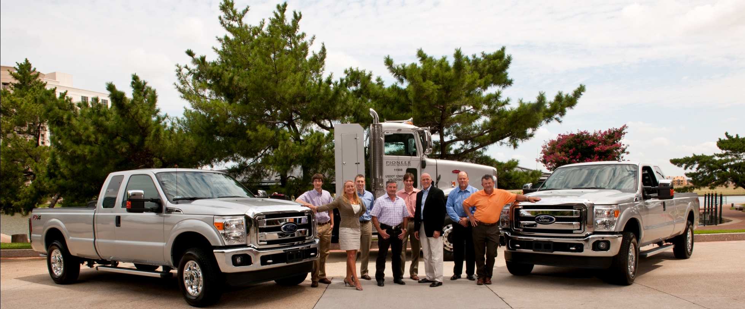
Pioneer’s Commitment to Natural Gas Vehicles & Engines
Westport Wing Bi-fuel F250 Fords with 24.5 GGE tanks with 325 Mile Range on CNG, additional 450 on gasoline for 775 total Range
Peterbilt Dedicated CNG Trucks with 1,000 Mile Range
Planning Natural Gas Powered Drilling Rig Project
Planning Natural Gas Powered Hydraulic Fracturing Project

Slide 19
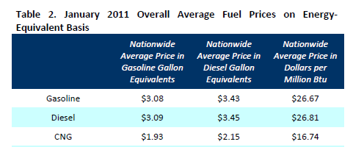
About Compressed Natural Gas (CNG)
CNG is a safer fuel than gasoline
The MPG for NGV are equivalent to gasoline powered vehicles
CNG fueling is equivalent to gasoline filling ~90 seconds
CNG vehicles reduce Volatile Organic Compounds 10%, Carbon Monoxide 20- 40%, Particulate Matter 80%, Greenhouse Gases 21-26%
CNG – octane level of 130, cleaner burning to optimize the fuel
1 MCF equals 7.5 Gallons of Gasoline (2.81/7.5 = .38 per GGE pre-tax and other)
Light Duty Truck Conversion Costs = $10K, Heavy Duty Conversion Costs = $45K
Station Costs CNG = $500K (small) - $1.5MM(large), LNG = $1.5M(small) - $2.5M(large)
CNG measured by Btu
GGE = Gasoline Gallon Equivalent
DGE = Diesel Gallon Equivalent
GGE
DGE
Btu
GGE
DGE
Btu
GGE
DGE
Btu
Notes:
Safety - Although CNG is flammable, it has a narrow flammability range, according to the U.S. Environmental Protection Agency, making it an inherently safe fuel. Strict safety standards make CNG vehicles as safe as gasoline-powered vehicles. In the event of a spill or accidental release, CNG poses no threat to land or water, as it is nontoxic. CNG also disperses rapidly, minimizing ignition risk when compared to gasoline. Natural gas is lighter than air and will not pool as a liquid or vapor. Nevertheless, indoor leaks can form a flammable mixture in the vicinity of an ignition source.
CNG is primarily methane, which is a greenhouse gas that could contribute to global climate change if leaked. Methane is slightly soluble in water and under certain anaerobic conditions does not biodegrade. If excess amounts accumulate, the gas can bubble in water creating a possible risk of fire or explosion.
Reported incidents of CNG bus fires are related to engine failures, not the use of natural gas. Natural gas buses have onboard gas detectors and other safety devices such as tank safety valves that only allow fuel flow when the engine is on. Also, the tanks must be periodically inspected by the U.S. Department of Transportation.
There are, however, some safety concerns with CNG buses compared to diesel fuel buses, such as greater breaking distance due to increased fuel storage system weight. This is a relatively small concern, however, because the fuel system is a small fraction of a bus’ total weight. CNG buses also might accelerate more slowly than their diesel counterparts.
With 24 Gallon CNG tanks these trucks also have similar range.

Slide 20
About Liquefied Natural Gas (LNG)
-260°F at normal pressure results in the condensation of the gas into liquid form
Clear, colorless, odorless, non-corrosive, and non-toxic
Removes oxygen, carbon dioxide, sulfur, and water from the natural gas, resulting in LNG that is almost pure methane
Converted to liquid form for ease of storage or transport in cryogenic tanks
Less than half the weight of water, so it will float if spilled on water
1/600th the volume of natural gas in the gaseous state
Principally used for transporting natural gas to markets, where it is regasified and distributed as pipeline natural gas
When the vapor mixes with air, it’s only flammable when mixture is between 5-15%t natural gas. When the mixture is less than 5% natural gas it doesn't burn. When the mixture is more than 15% natural gas in air, there is not enough oxygen for it to burn

Slide 21
Contact Information
Tadd Owens
Director – Government Affairs
Pioneer Natural Resources USA, Inc.
5205 N. O’Connor Blvd, Suite 200
Irving, TX 75039-3746
Direct – 972-969-5760
Tadd.Owens@pxd.com
Lynn Lyon
Director – Fuel Marketing
Pioneer Natural Resources USA, Inc.
5205 N. O’Connor Blvd, Suite 200
Irving, TX 75039-3746
Direct – 972-969-4484
Mobile – 972-897-8022
Lynn.Lyon@pxd.com
For updates on the NGV market in TX and beyond:
LinkedIn http://www.linkedin.com/in/lynnlyon
Twitter - @lynnmurraylyon
The TX Clean Transportation Triangle - developing a profitable, sustainable and growing market for natural gas vehicles in TX

