Slide 1
2013 Legislative Summit Energy in Texas: Threats and Opportunities
James Mann
Duggins Wren Mann & Romero, LLP
February 4, 2013

Slide 2
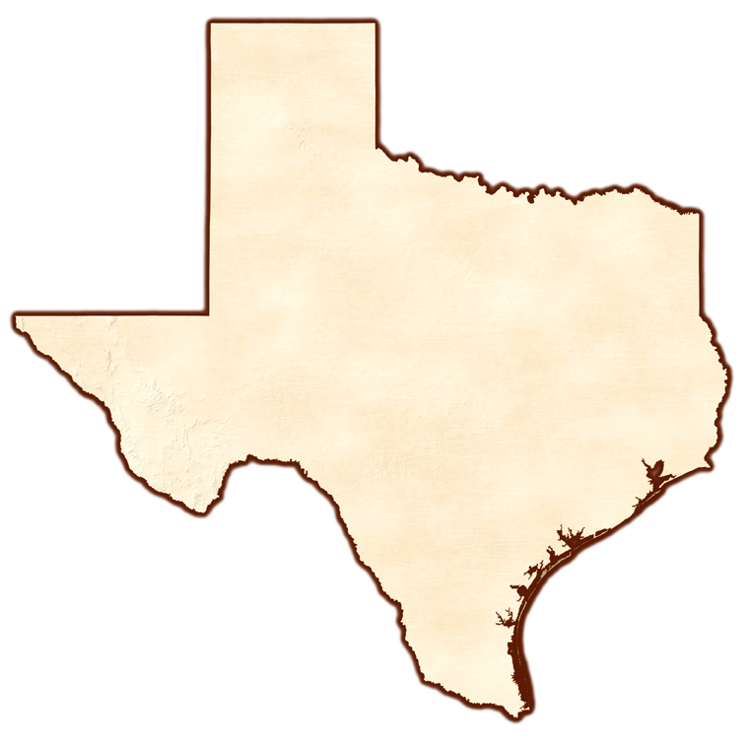
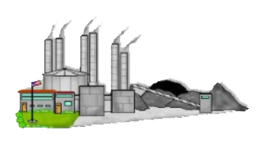
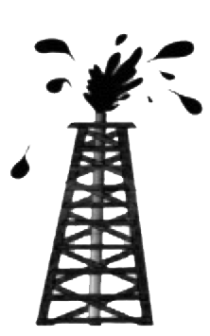
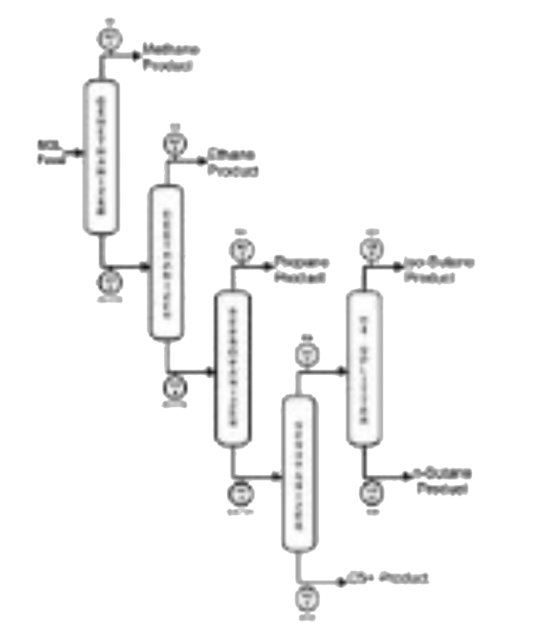
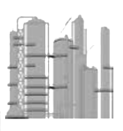
Texas ENERGY
-in the last 3 years-
Processing plant
Processing plant
DFW
Electric Generating Plant
Austin
Chemical Plant
Processing plant
Fractionator
Houston
Refinery
Beaumont
Chemical Plant
Chemical Plant
Freeport
Drilled 30,000 new wells
Refinery expansion
Chemical plant
Fractionator expansion
Refinery
Corpus Christi

Slide 3
Texas ENERGY
-in the last 3 years-
Processing plant
Processing plant
DFW
Electric Generating Plant
Austin
Chemical Plant
Processing plant
Fractionator
Houston
Refinery
Beaumont
Chemical Plant
Chemical Plant
Freeport
Drilled 30,000 new wells
Refinery expansion
Chemical plant
Fractionator expansion
Refinery
Corpus Christi

Slide 4
