Slide 1
An Overview of the Energy Industry in Texas
Presentation to the 2013 Legislative Summit
Energy in Texas: Threats and Opportunities
Austin, Texas
By:
Bernard L. Weinstein, Ph.D.
Maguire Energy Institute, Cox School of Business
Southern Methodist University
Dallas, Texas
February 4, 2013

Slide 2
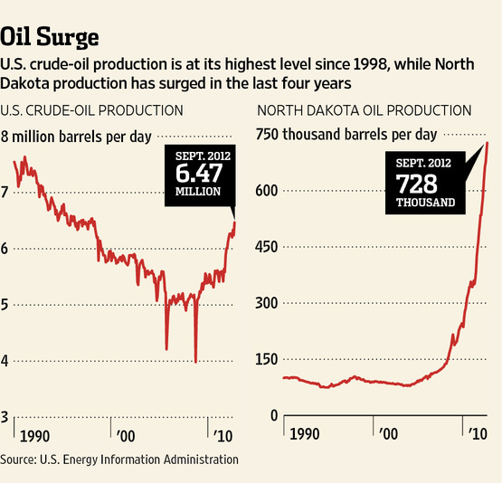

Slide 3
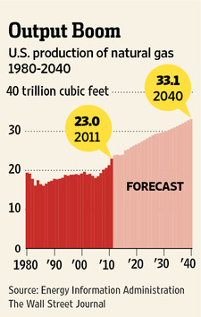

Slide 4
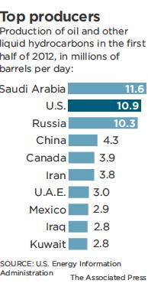

Slide 5
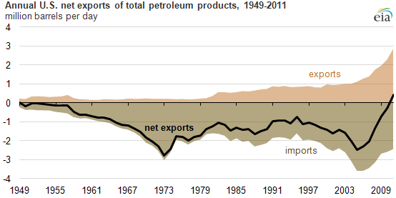

Slide 6
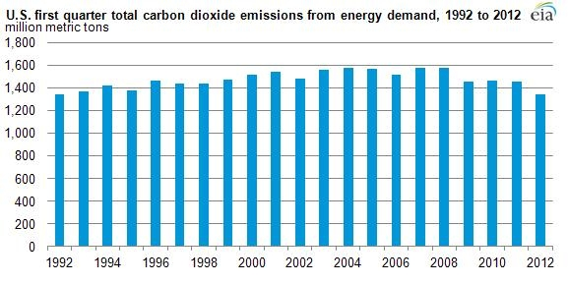

Slide 7
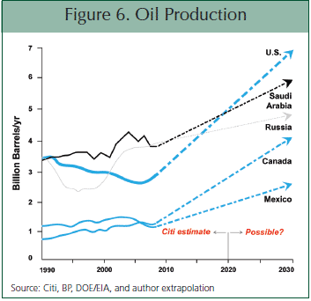

Slide 8
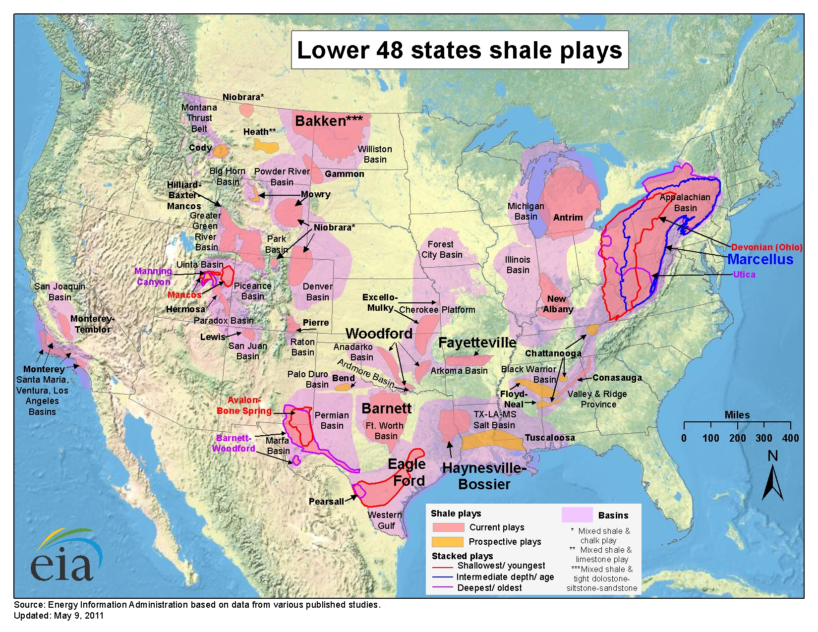

Slide 9
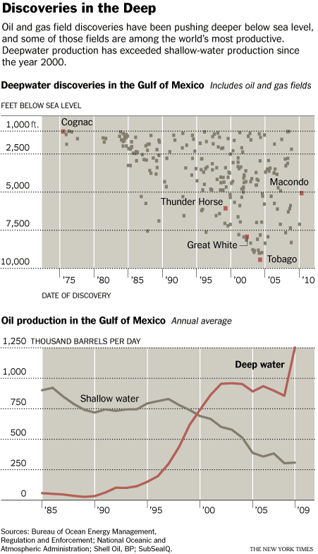

Slide 10
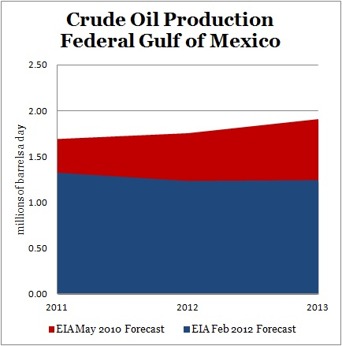

Slide 11
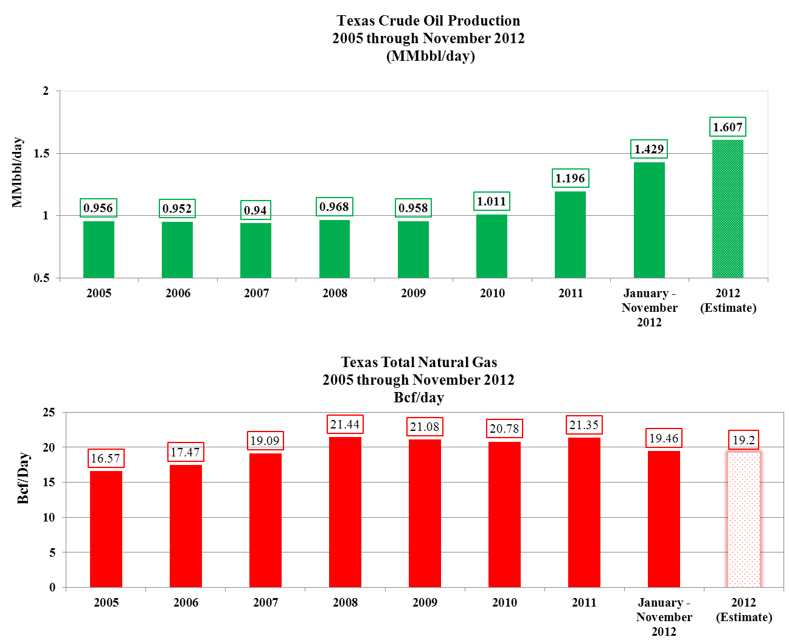

Slide 12
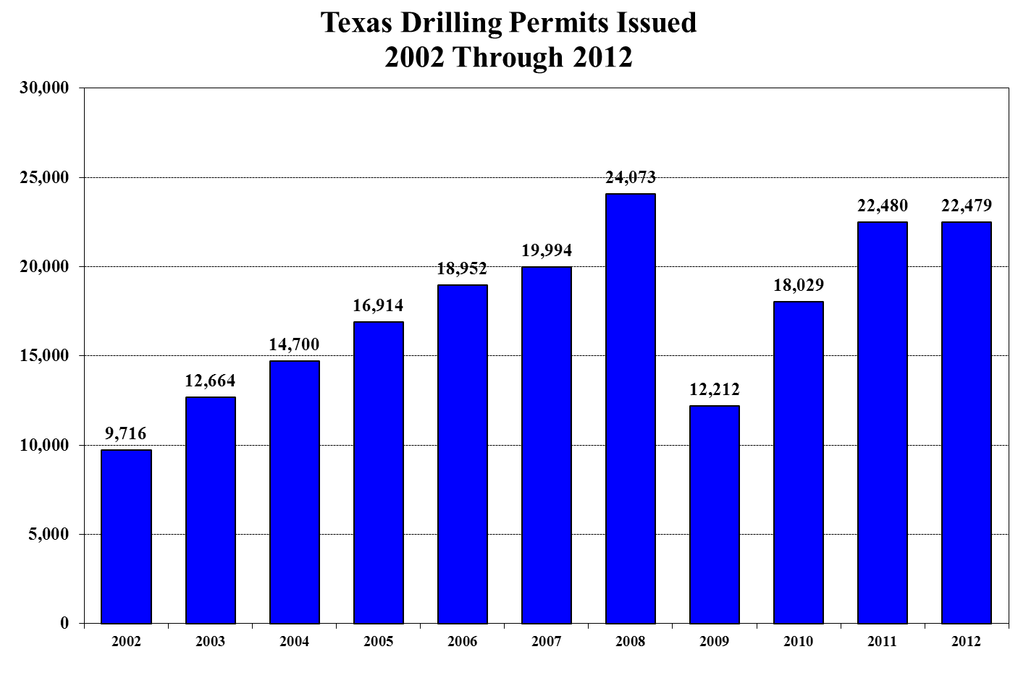

Slide 13
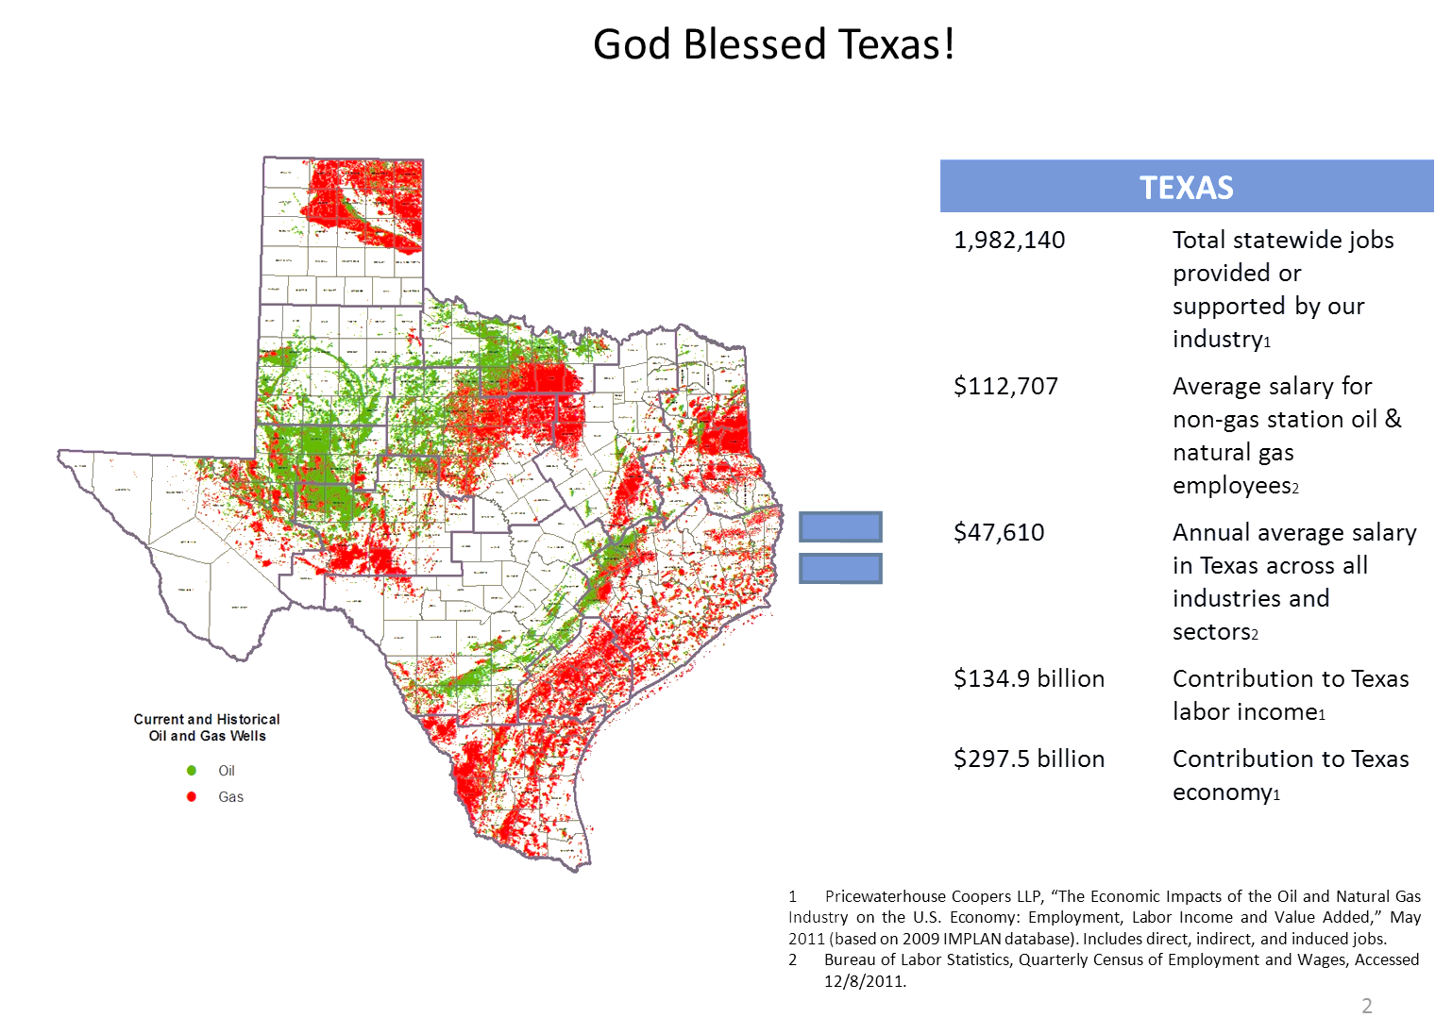
Economic Impacts of Energy Industry

Slide 14
Oil and Gas payrolls have grown 33% since 1997 compared to total nonfarm payrolls in Texas, which have grown 15% in that same time period

Slide 15
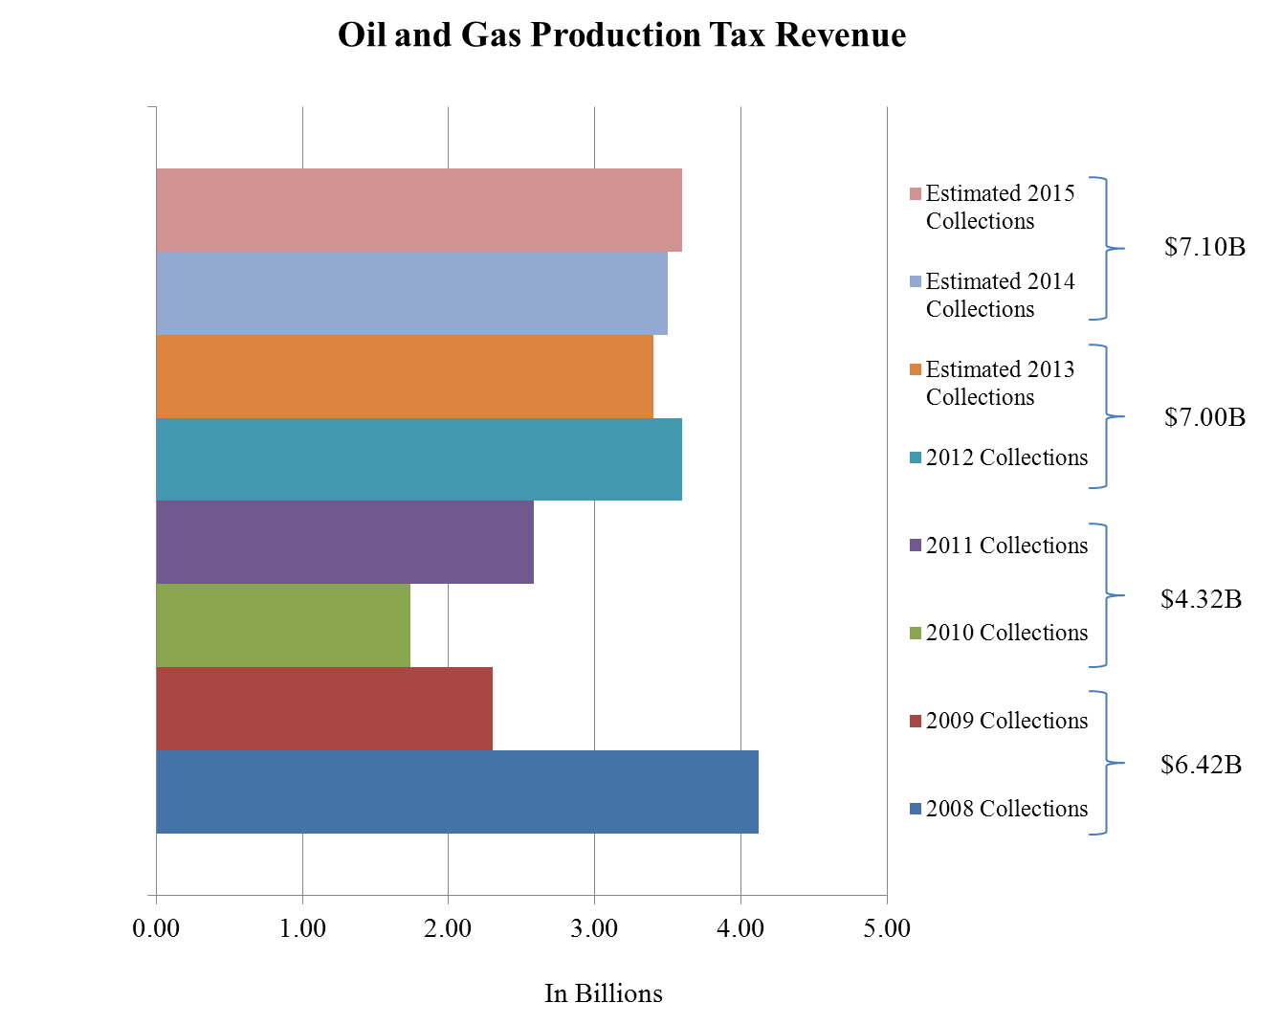

Slide 16
Oil and Gas production taxes have grown 156% since 1992 compared to total taxes collected in the state of Texas, which have grown 145% in that same time period Production tax revenue has increased from $1 billion in 1992 to over $2.5 billion at of the end of 2011 Note: Does not include $1.35 billion in sales taxes paid by energy industry in 2011.

Slide 17
Challenges and Opportunities

Slide 19
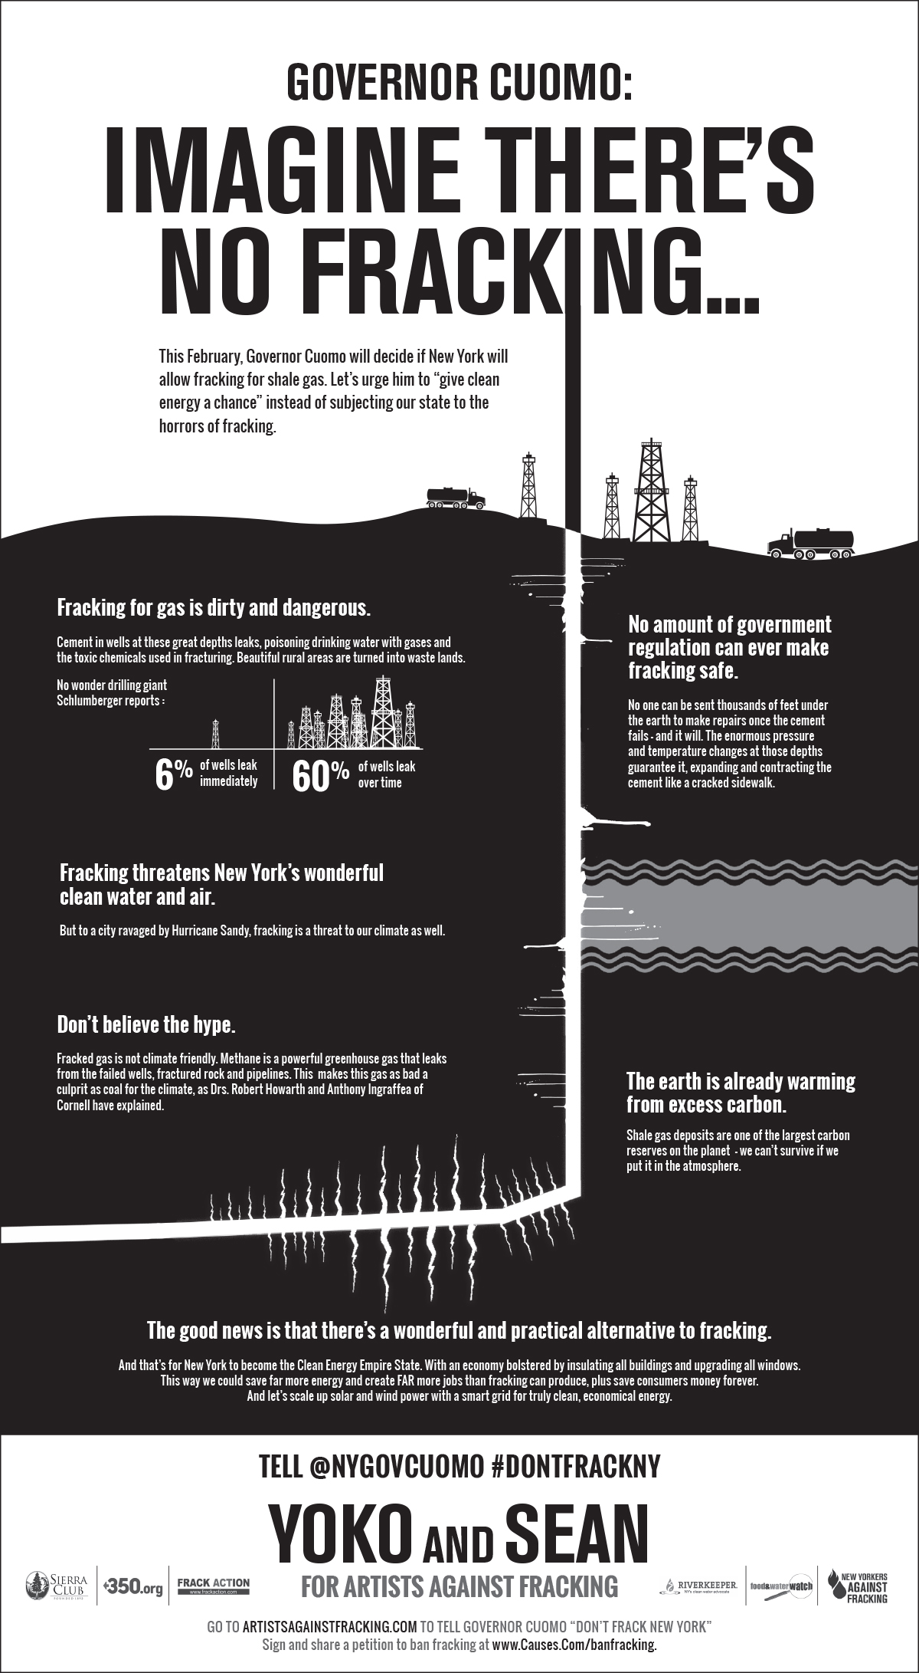

Slide 21
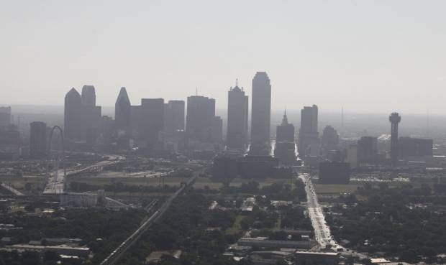
Air Quality Issue #1

Slide 22
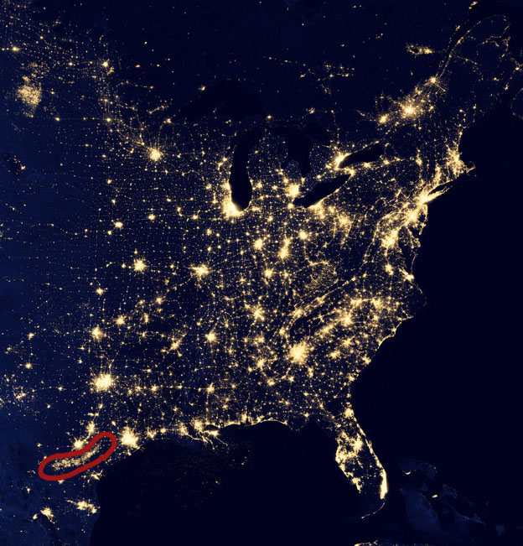
Air Quality Issue #2

Slide 23
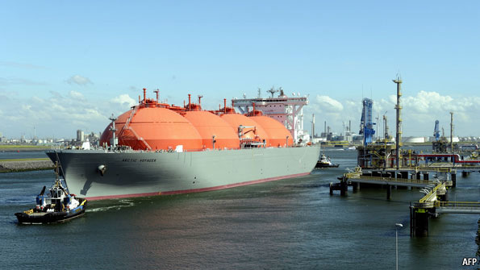

Slide 25
