Slide 1





Slide 2


The Electrical Safety Foundation Intl.
The Electrical Safety Foundation International (ESFI) is the premier non-profit 501(c)3organization dedicated exclusively to promoting electrical safety at home and in the workplace through education, awareness and advocacy.
Founded in 1994 as a cooperative effort by the National Electrical Manufacturers Association (NEMA), Underwriters Laboratories (UL), and the U.S. Consumer Product Safety Commission (CPSC).
ESFI an international presence and
voice with affiliates in Canada and Mexico.

Slide 3

Supply Channel Influence
Federal and Local Govt.
Utilities
Insurers
Certification Labs
Code Making Bodies
Associations
Manufacturers
Distributors
Retailers
Fire Service
Educators
Contractors
Children

Slide 4



















Leveraging ESFI Supporters

Slide 5

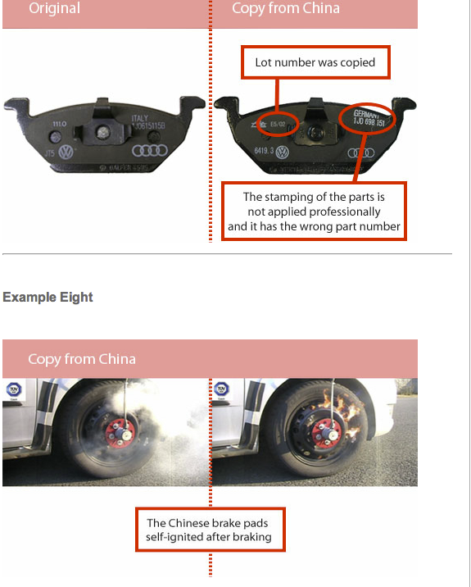
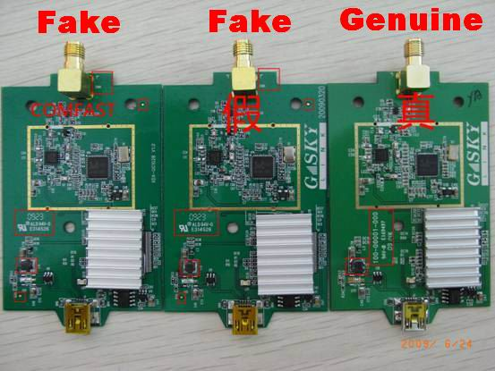
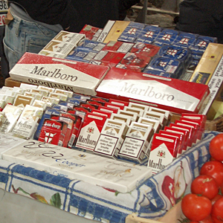
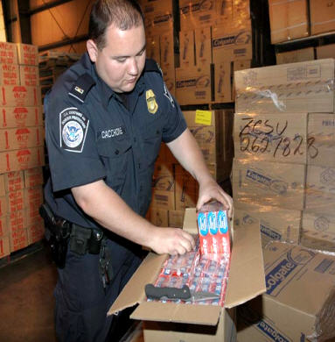
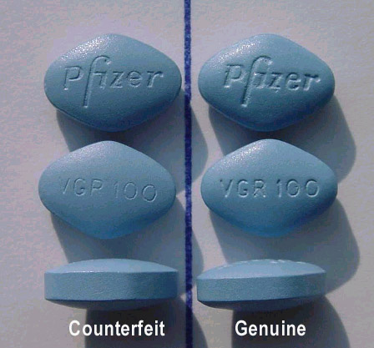
Health and Safety Impact

Slide 6
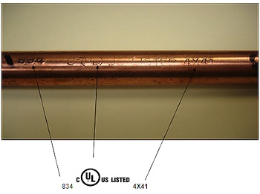
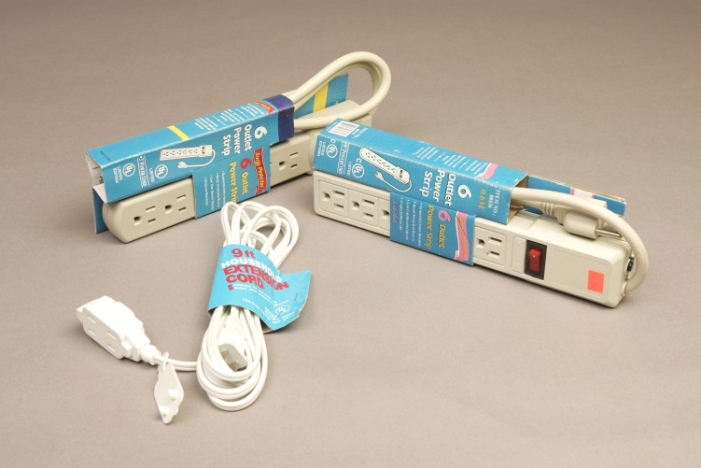
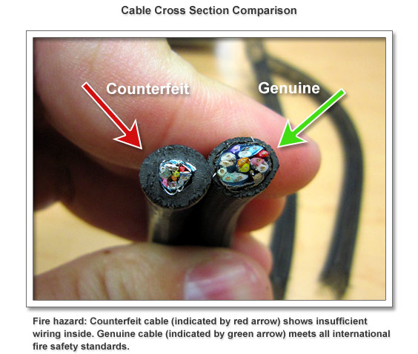
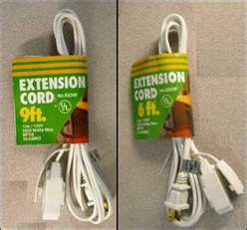
Industry Counterfeits

Slide 7
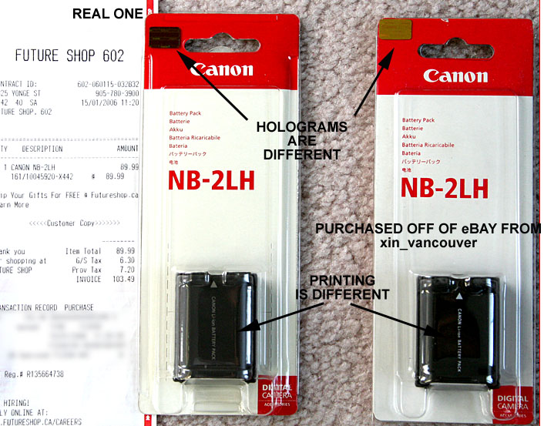
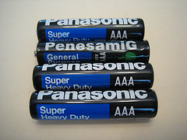
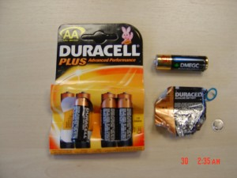
Industry Counterfeits

Slide 8
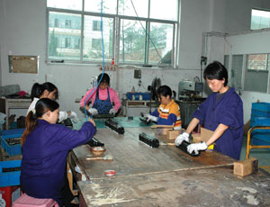
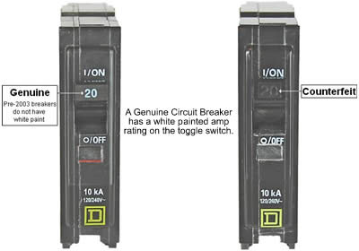
Industry Counterfeits

Slide 9
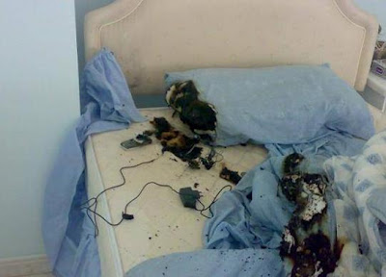

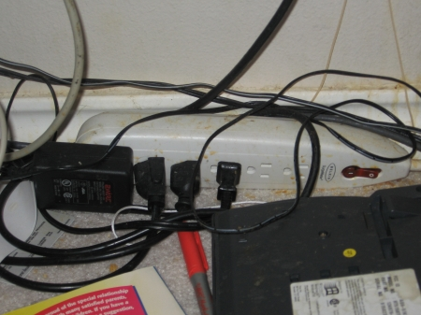
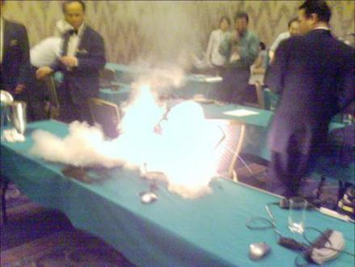
This CAN happen to you.

Slide 10
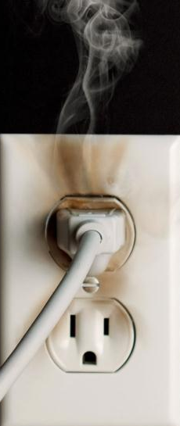
Situation Analysis
Intellectual Property Right seizures in 2011 increased by 24%, a 325% increase over the past decade.
Consumer Safety and Critical Technology seizures increased by 44% in 2011. Consumer electronics/devices represented 22% of these seizures.
Consumer electronics/devices were the top commodity seized in 2011, with the value of seizures increasing by 16%.

Slide 11

Situation Analysis
It is estimated that the circuit breaker industry alone lost $125,000,000 in the U.S. and $200,000,000+ worldwide over the last 5 years.
It is estimated that Mexico's electrical market is made up of 70%+ counterfeit devices.
Estimates are similar in the middle east and Asia

Slide 12

Common Questions ?
Ways counterfeits can get into the channel…
  “Grey Market”
  “Excess inventory” (pricing breaks)
  Fake certification marks/not certified for use in all markets
  Not doing diligence/trusted supplier
    (Don’t know what you don’t know)
  Repurposing/reclassifying product (not for intended use)
  Commingling legitimate product with counterfeits
  Distributors going outside of normal channel
    (Product or brand specific need)

Slide 13

ESFI Operation A.C.T. Strategy
ESFI will serve as the unbiased and unified voice, drawing the correlation between safety and reliability.
Build on existing programs, insulating brands and marks from being associated with unsafe counterfeit products.
Work with consumer, industry, association, and government stakeholders using a sustained and multifaceted approach, focused on HEALTH AND SAFETY.
A global perspective; cultivating relationships with international law enforcement, industry, and government partners.

Slide 14
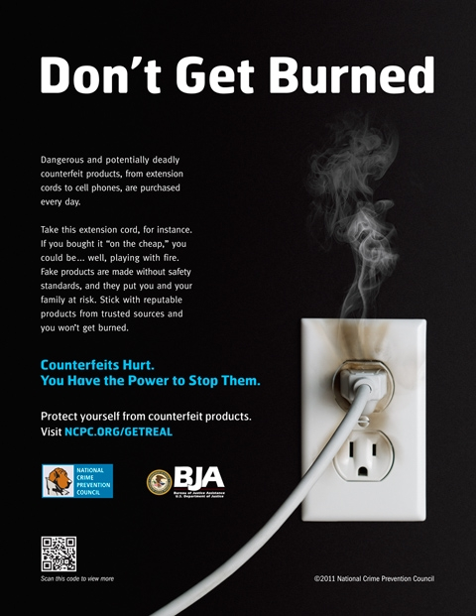

14
14

Slide 15


Contact Information:
Brett Brenner
President
(703) 841-3296
Bre_Brenner@esfi.org
www.ESFI.org

