Slide 1
Counterfeit Medicines Protecting Patients Against the Threat
John P Clark
Chief Security Officer, Vice President Global Security
February 2013
Notes:
For Pfizer, counterfeit medicines are, first and foremost, an issue of patient health and safety. It is a global problem, one from which no region, country, therapeutic area is immune.
It is for that reason that we have implemented an aggressive anti-counterfeiting program to detect and disrupt major manufacturers and distributors of counterfeit medicines.
And it is also why we welcome opportunities to raise awareness, among policy makers, enforcement and regulatory authorities, healthcare professionals, and patients to the threat that those medicines may pose.

Slide 2
Counterfeit Pfizer Medicines Confirmed
From in at least 75 countries as of December 31, 2007…
… to in at least as 106 as of December 31, 2012.

Slide 3
Legitimate Supply Chains Breached
From counterfeit versions of 7 Pfizer medicines in 23 countries as of December 31, 2007…
…to counterfeit versions of 24 Pfizer medicines in 59 countries as of December 31, 2012.

Slide 4
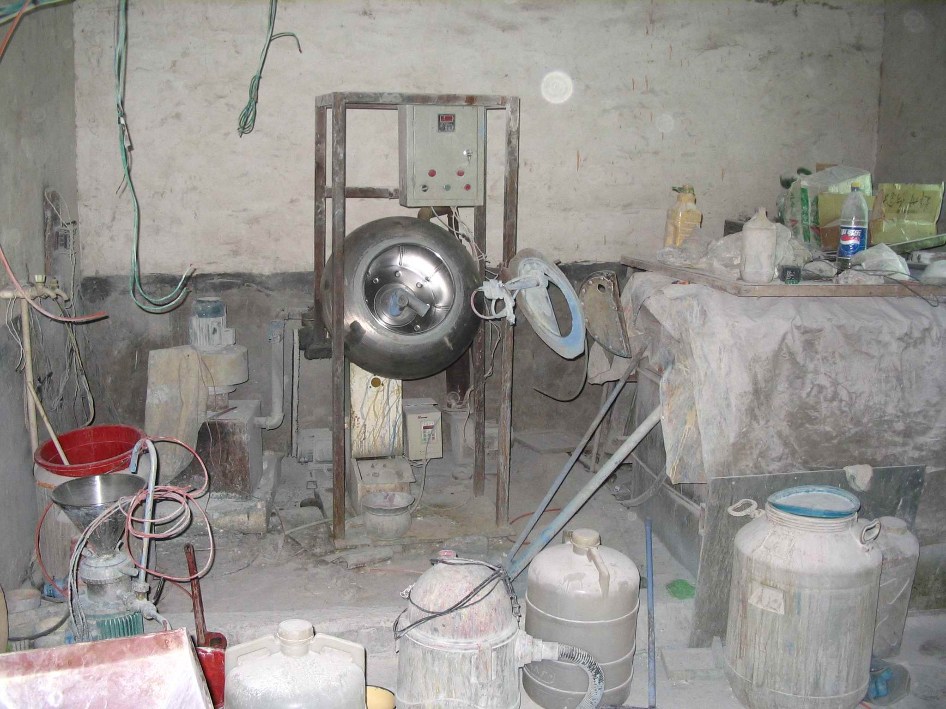
Manufactured Under Conditions Like This…

Slide 7
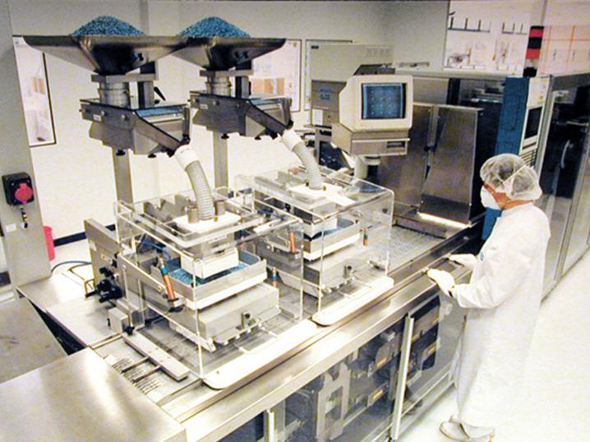
…Rather Than Like These…

Slide 8
May Contain …
No active ingredient | Chalk
Wrong active ingredient | Wallboard
Pesticides | Brick dust
Heavy metals | Printer ink
Arsenic | Leaded highway paint

Slide 9
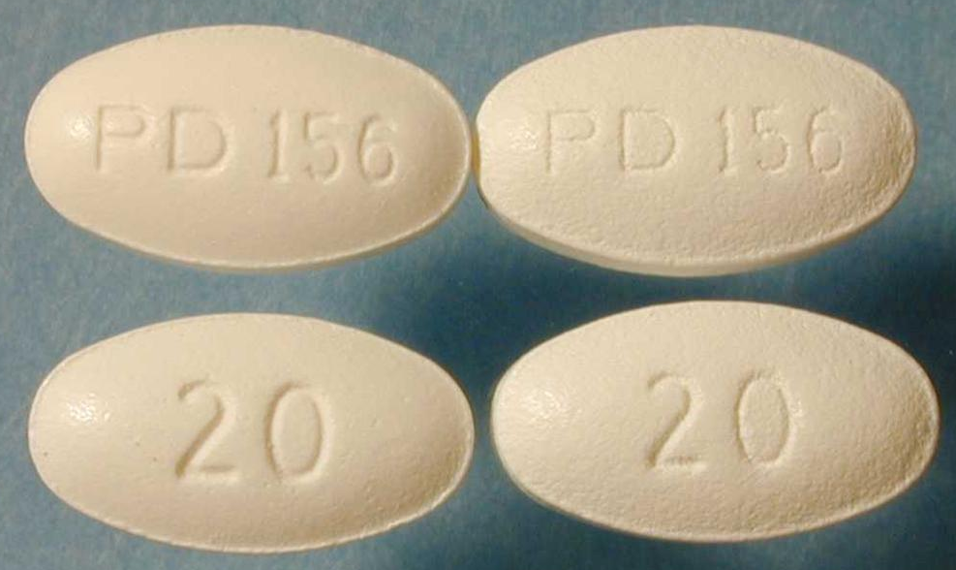
… But Virtually Indistinguishable
9
Notes:
Counterfeits also pose a threat because, due to advances in technology, it is virtually impossible to tell the fake from the authentic.
This photo is a comparison of counterfeit Lipitor recalled from US supply chain in 2003 and authentic Lipitor. Can you tell the difference?
Although the counterfeits (left) are virtually indistinguishable from the authentic tablets (right), differences in their coating may have affected the efficacy of the counterfeits.
Pfizer was alerted to these counterfeits by complaints from patients that the tablets dissolved quickly and had a bitter taste.

Slide 10
Thank You!

