Slide 1
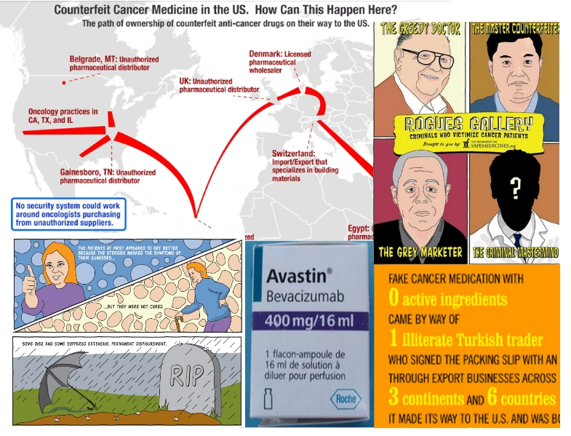
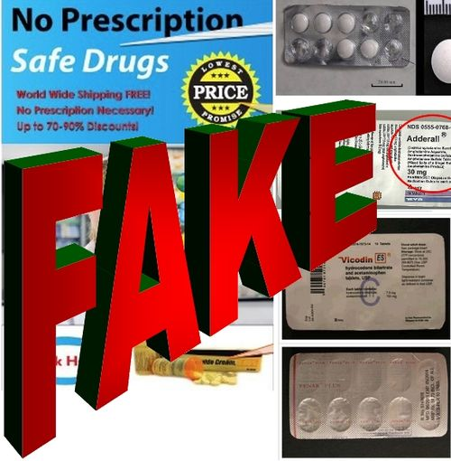
Counterfeit medications in the US and worldwide
Scott A. LaGanga, Executive Director The Partnership for Safe Medicines
February 28, 2013
Notes:
The Partnership For Safe Medicines is a partnership of more than 70 non-profit organizations, committed to protecting patients from fake drugs. We focus on educating patients and healthcare professionals about the risks and dangers of counterfeit, substandard or otherwise unsafe medicine.
Learn more about our efforts at www.safemedicines.org.
Sign up for our newsletter at http://safedr.ug/joinpsmlist.

Slide 2
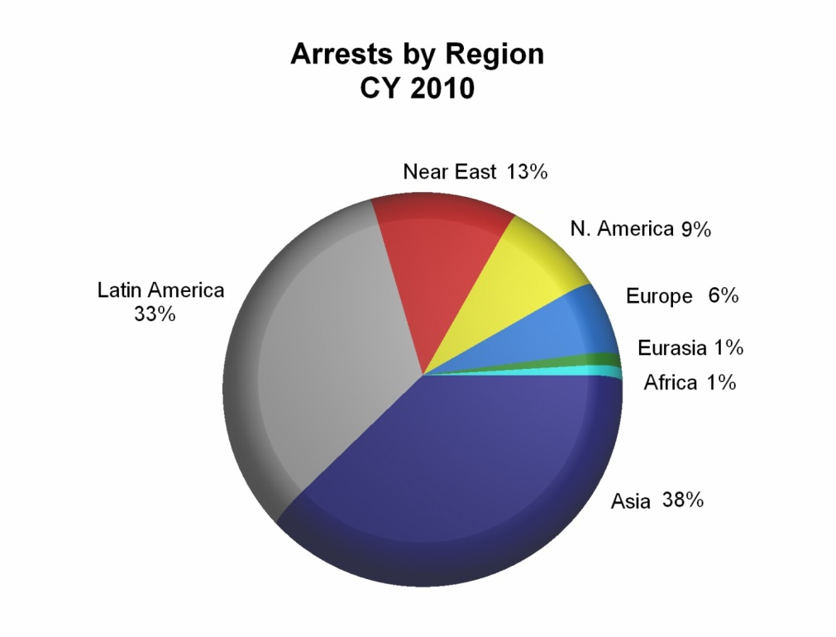
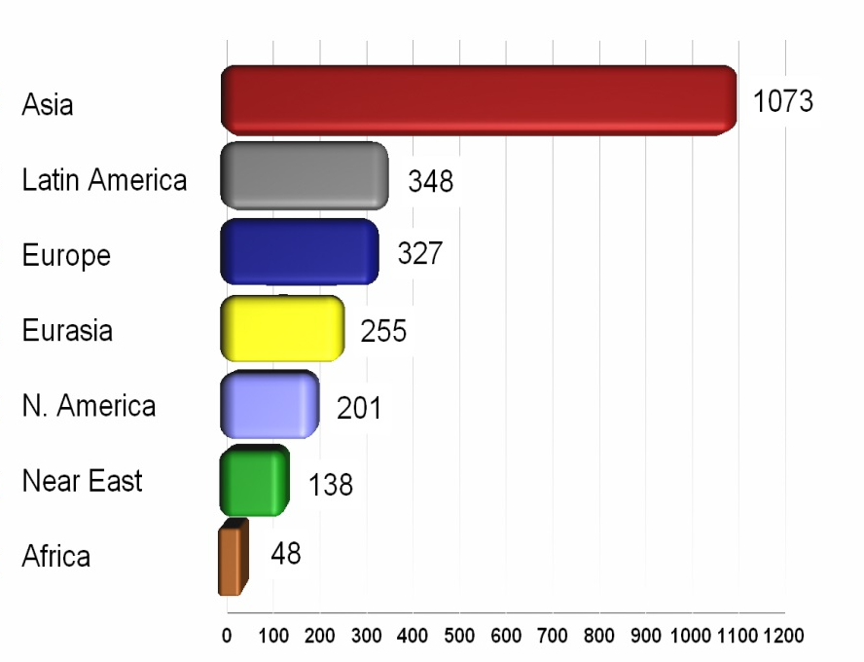
INTERPOL’s Pangea V – 2012
7,000 illicit packages seized
3,750,000 illicit & counterfeit pills found
79 people arrested in
100 countries
Reported incidents by region
In parts of the world about
1 in 3 medical products are counterfeit.
But a teenager in Boston can buy fake drugs online from Canada that were made in India and shipped directly from
Barbados.
Data courtesy of PSI and INTERPOL.
Notes:
According to INTERPOL, the extent of the problem is impossible to quantify, but in parts of the world about 1/3 of all medical products are counterfeit.
To understand the breadth of these crimes, we can look at INTERPOL’s statistics from Operation Pangea V in 2012. The world-wide coordinated crack down on counterfeit medications resulted in the seizure of almost 7,000 illicit packages containing 3.75 million illicit and counterfeit pills. However only 79 people were arrested across 100 countries (INTERPOL, 2012).

Slide 3
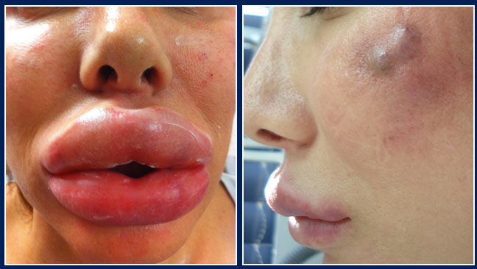
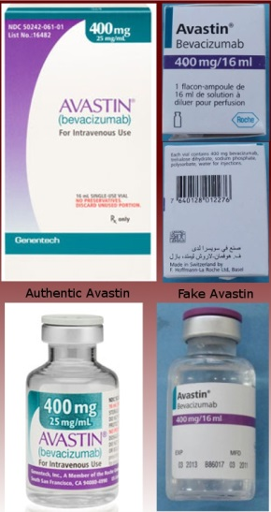
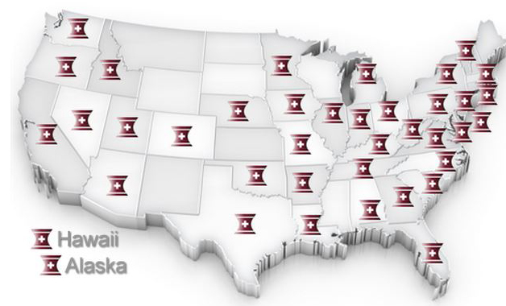
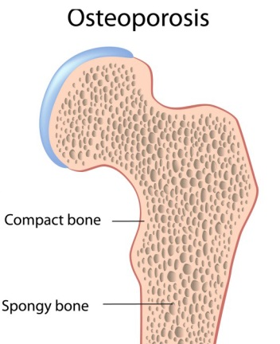
Botox
Fax advertisements offer unrealistic discounts on expensive and popular medications.
The doctors aren’t passing those savings on to their patients, nor are they letting them know where they got the medication from.
Avastin
Altuzan
Aclasta
Prolia
States with doctors warned about unapproved medications by the FDA.
Notes:
Direct at the Doctor’s Office - Three separate batches of counterfeit cancer medications have found their way into US clinics.
134 clinics have now been warned they may have purchased fake cancer drugs from several foreign supplier, and one US supplier.
6 US citizens have been prosecuted for buying or distributing counterfeit cancer medications, including suppliers, office managers and doctors.
Both fake Botox and fake osteoporosis drugs have been found from the same set of unauthorized distributors setting off FDA warnings to their customers.
In total, the FDA has warned more than 370 doctors in 38 states and one hospital that they may have purchased counterfeit medications for their patients’ care.
Unscrupulous wholesalers, mostly foreign, send fax blasts to doctor’s offices offering unrealistic discounts on expensive and popular medications.

Slide 4
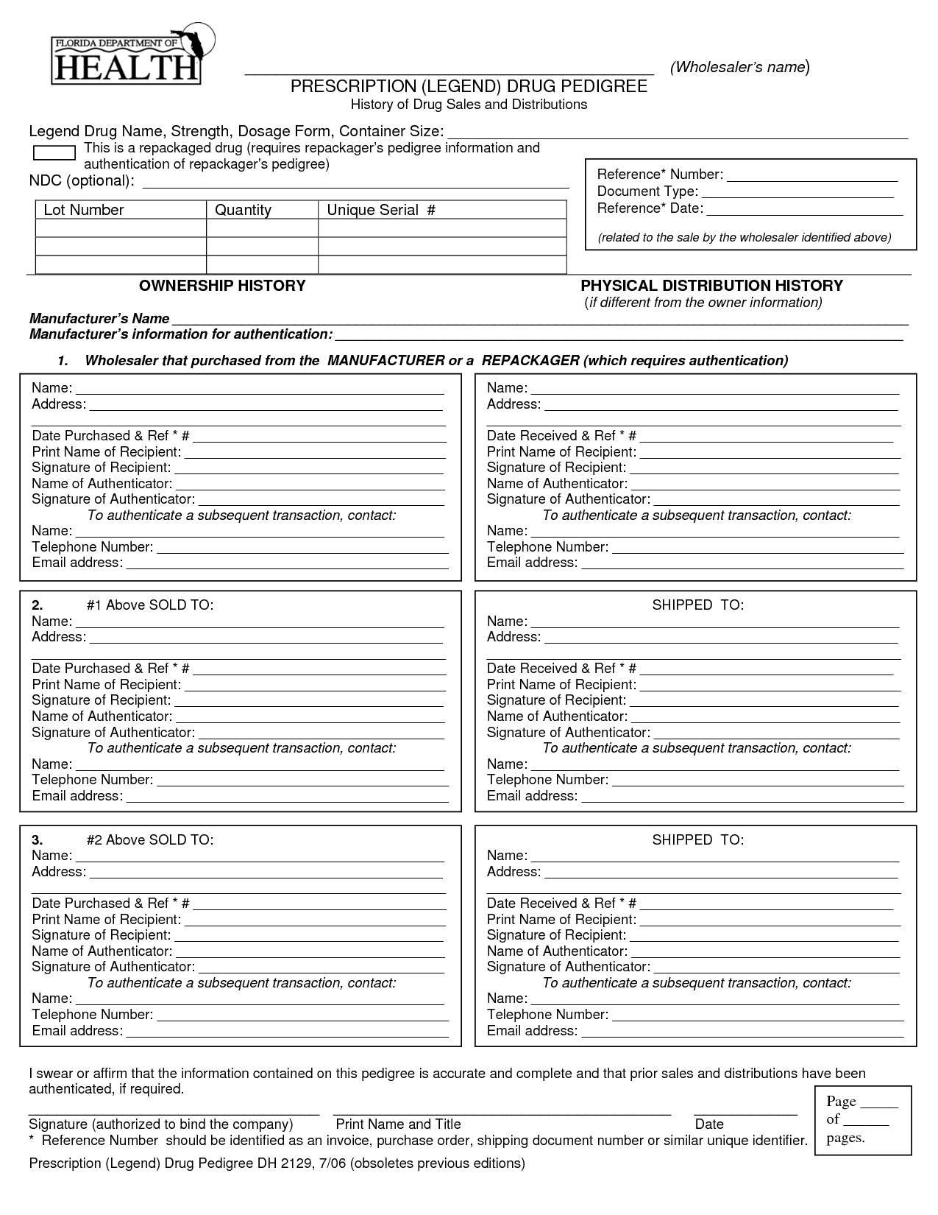
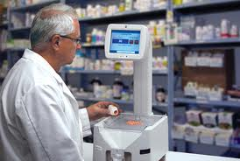
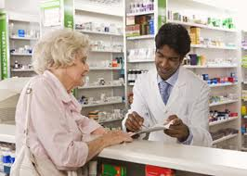
FAKE
Stolen and diverted medications with fake pedigrees ended up directly in the hands of pharmacy patients.
Notes:
Counterfeit and diverted drugs have been also found in traditional, bricks & mortar pharmacies.
Last year, a specialty pharmacy was prosecuted for selling diverted HIV medication worth millions. In another case, a distribution company, Altec Medical, was prosecuted for paying $55 million for stolen drugs with fake pedigrees meant to insure authenticity.

Slide 5
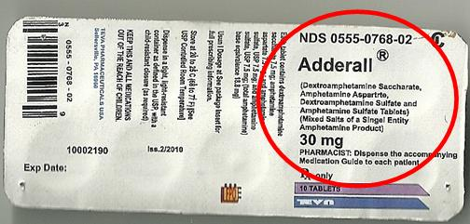
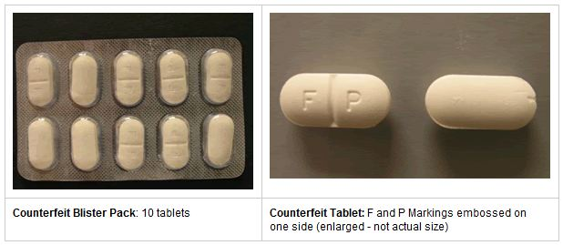
Fake Adderall contained Tramadol and acetominophen
5 separate prosecutions of fake medications sold via fake online pharmacies in 2012
One case alone estimated $95 million in fraud selling unapproved drugs to Americans
Fake Vicodin contained NSAIDs
What ELSE are we getting?
Notes:
The FDA warned patients that both counterfeit Adderall and counterfeit Vicodin had been found on the internet. But medications contained active ingredients, of other medicines, that could have seriously harmed patients. The Adderall contained Tramadol and acetaminophen instead, both pain relievers, instead of the psychostimulant medication expected. The fake Vicodin contained NSAIDs instead.
These two FDA warnings are just a sample of the variety of fake medications sold online.
This year alone, in the US there were 5 separate prosecutions of fake medications sold via fake online pharmacies, one alone which conspired “to commit $95 million worth of mail fraud” by selling unapproved medication to Americans.

Slide 6
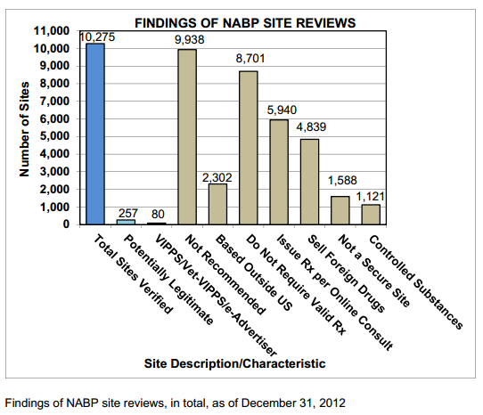
97% of more than 10,000 websites sampled were out of compliance with laws and pharmacy practice standards.
1 in 6 Americans buy drugs on the Internet without a prescription.
Notes:
The National Association of Boards of Pharmacy (NABP) has determined from sampling for three years running, 97% of more than 10,000 websites analyzed were out of compliance with state and federal laws and or/NABP patient safety and pharmacy practice standards.
A December 2010 study by the Partnership at Drugfree.org found that 1 in 6 American obtain prescription drugs via the Internet without a valid prescription.
Read the most recent NABP report.
http://safedr.ug/15jcpkf

Slide 7
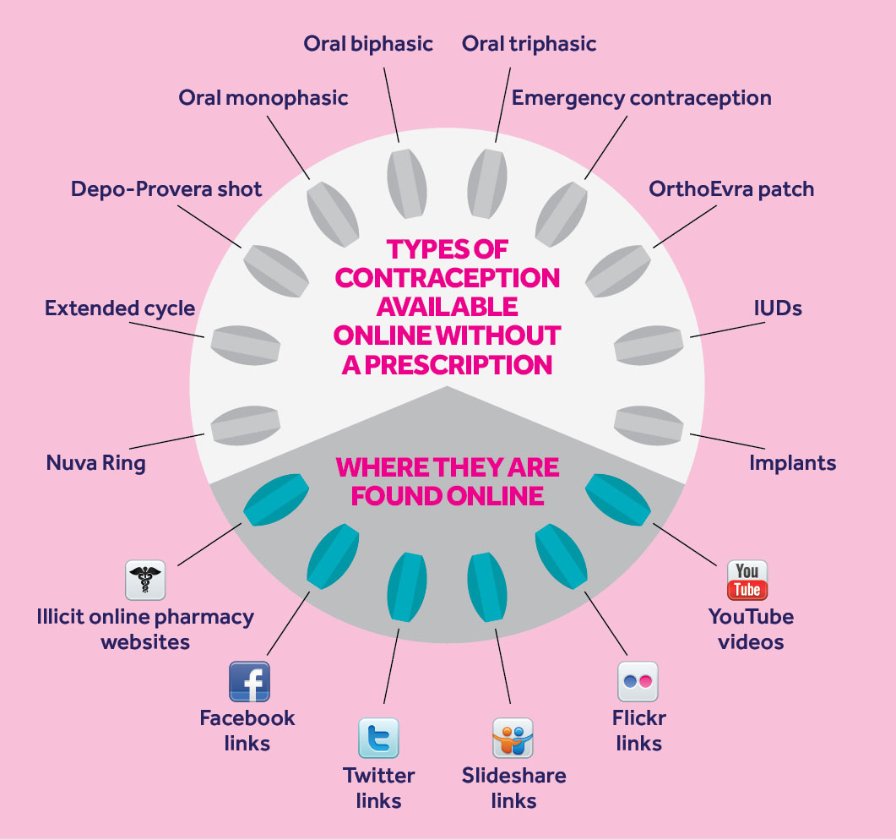
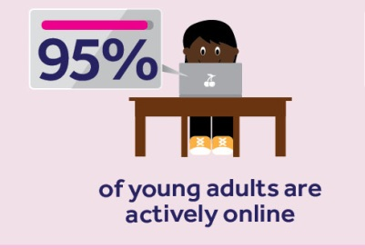
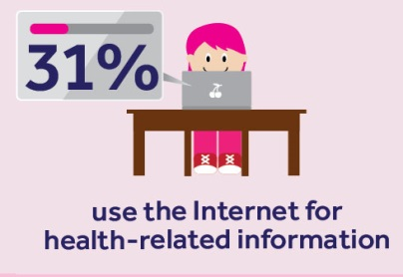
YouTube videos and cartoons teach IUD and implant insertion and removal,
despite the risk of infection and death.
Notes:
Social media sites, such as Facebook, and instructional websites, like YouTube, are effectively subverting medicine safety protocols.
Implant and IUD contraception is available online, with self-help videos for treatment. Research funded by PSM and presented at our annual conference last October brought this danger to light.
Learn more about The Dangers of Contraception Purchased Online.
http://safedr.ug/IUDonline

Slide 8
Women’s Health Risks From Counterfeit Medicines
Notes:
Learn more about Women’s Health Risks from Counterfeit Medicines.
http://safedr.ug/Whlth

Slide 9
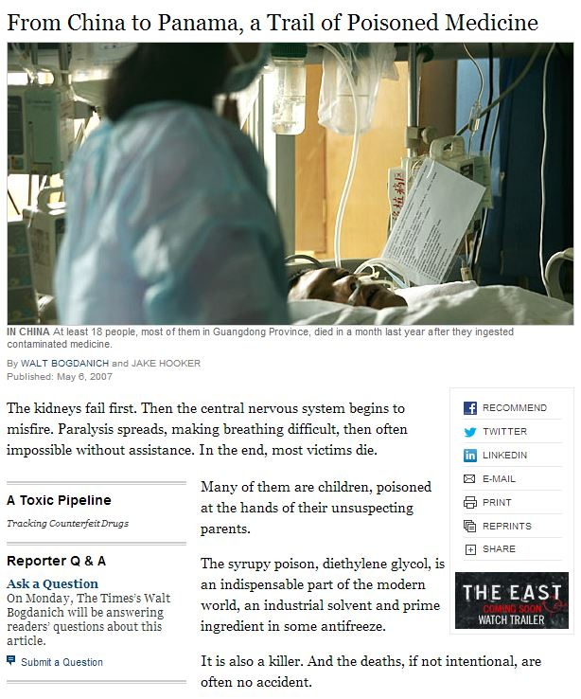
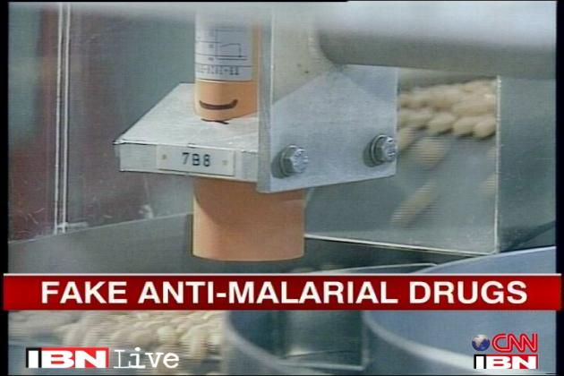
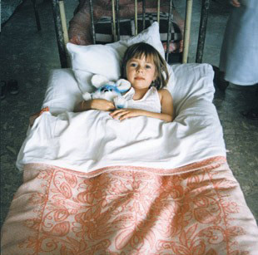
FAKE COUGH SYRUP
FAKE ANTIBIOTICS
Notes:
Counterfeit cough syrup references:
http://safedr.ug/XZdt6N
http://safedr.ug/WrKyc2
Counterfeit malaria drug references:
http://www.bbc.co.uk/news/health-18147085
Counterfeit antibiotic referencess:
http://safedr.ug/XEGCov
http://safedr.ug/XflWp7
http://safedr.ug/WeXjw1

Slide 10
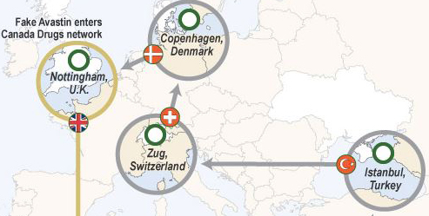
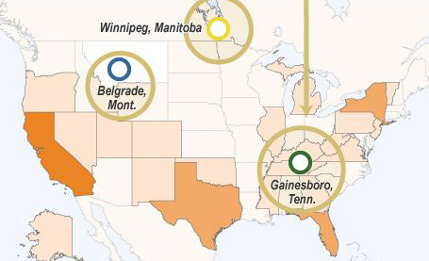
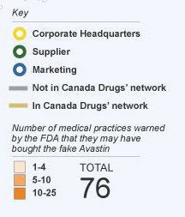
Map graphic courtesy of the Wall Street Journal.
Notes:
References for the counterfeit cancer drug case:
http://www.fda.gov/Drugs/DrugSafety/ucm291960.htm
http://online.wsj.com/article/SB10001424052702303879604577410430607090226.html

Slide 11
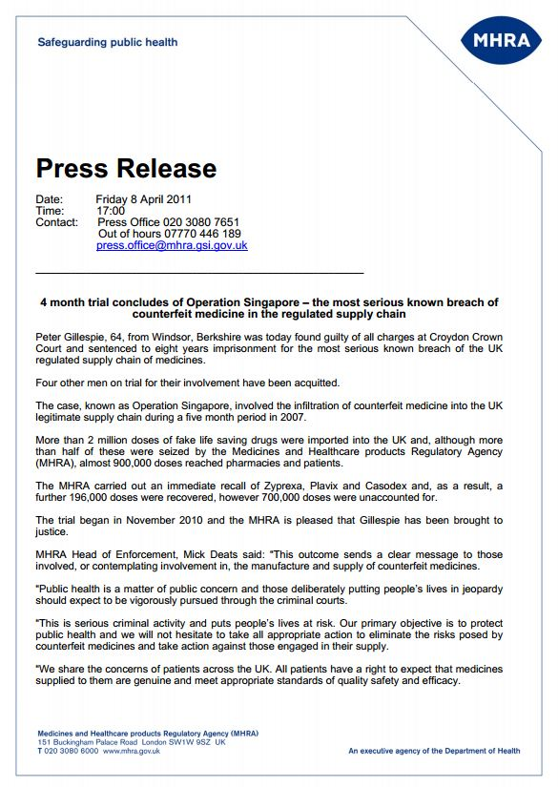
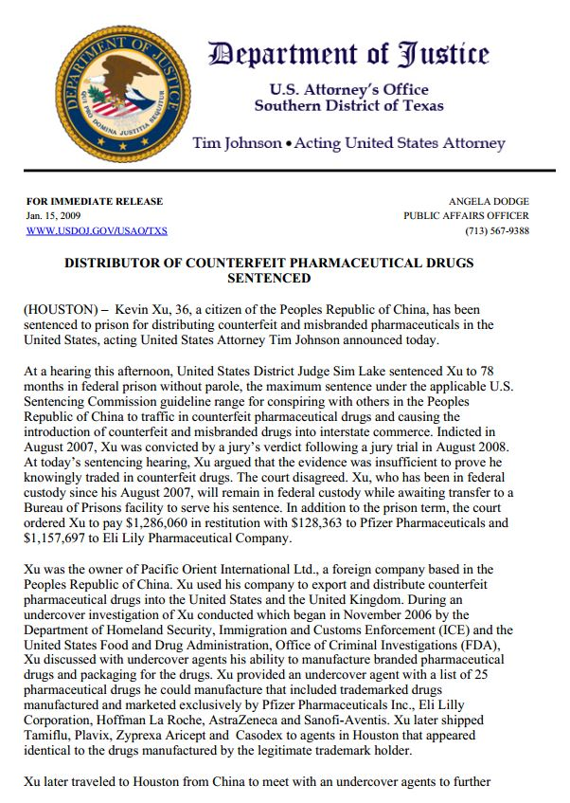
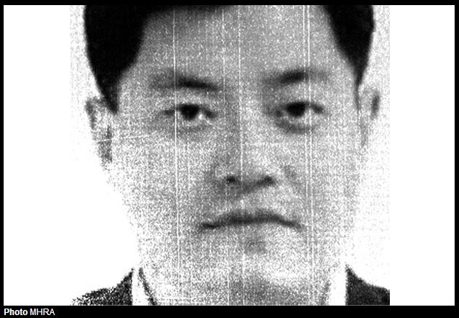
Notes:
Coverage on Peter Gillespie case:
http://safedr.ug/VO2q3G
Coverage of Kevin Xu case:
http://safedr.ug/Y0Wuks

Slide 12
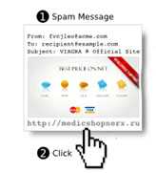
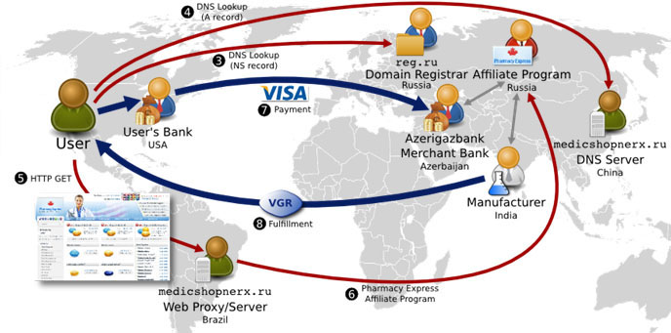
Affiliate networks of criminals distribute counterfeit medicines through websites and emails around the world
Notes:
Research into affiliate networks has been presented at the Partnership for Safe Medicine’s Interchange. George Mason Associate Professor Damon McCoy presented “Payment Processing and Unlicensed Online Pharmacies.”
Presentation available here:
http://www.slideshare.net/SafeMedicines/damon-mc-coy
Watch his presentation here:
http://www.c-spanvideo.org/clip/4004293

Slide 13
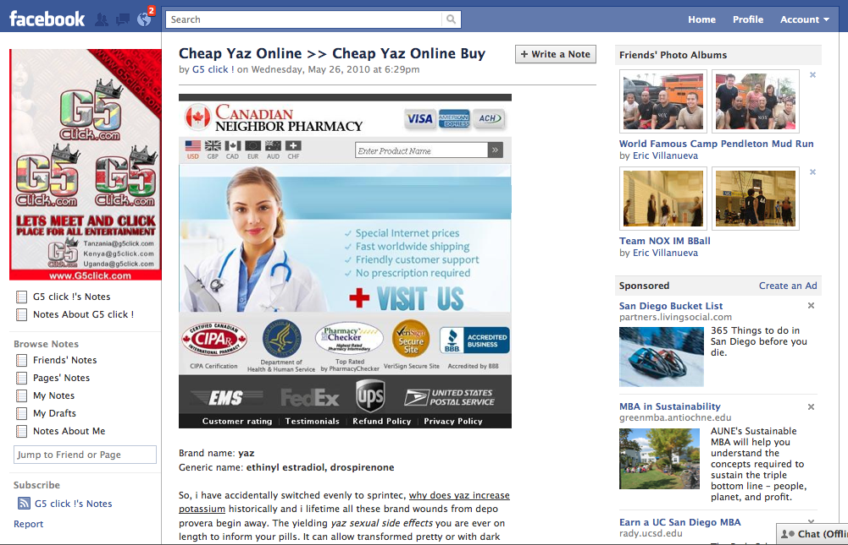
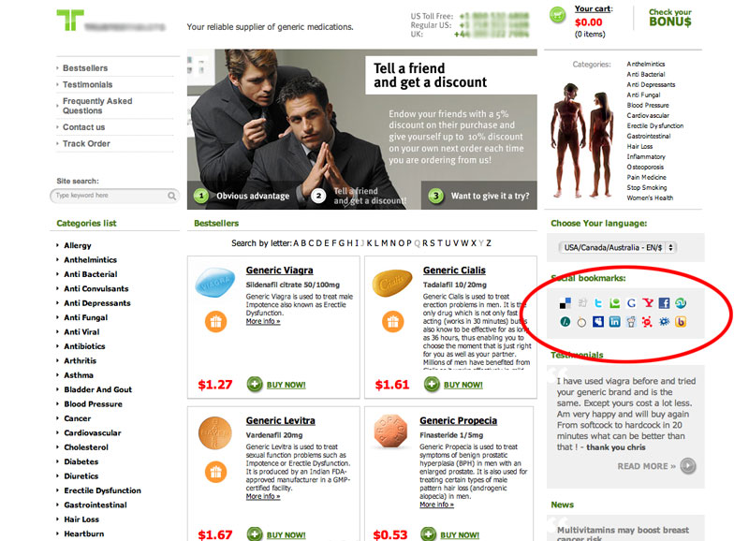
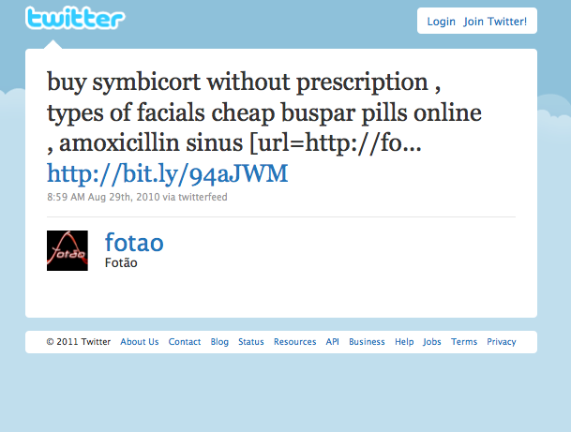
13
Notes:
Research into the Social media impact on direct-to-consumer marketing of counterfeit medicines was presented at the 2012 Partnership for Safe Medicine’s Interchange by Tim K. Mackey.
His presentation is available here:
http://safedr.ug/Xj3N9W
Watch his presentation here:
http://www.c-spanvideo.org/clip/4007311

Slide 14
Notes:
To be VIPPS accredited, a pharmacy must comply with the licensing and inspection requirements of their state and each state to which they dispense pharmaceuticals. In addition, pharmacies displaying the VIPPS seal have demonstrated to National Association of Boards of Pharmacy compliance with VIPPS criteria including patient rights to privacy, authentication and security of prescription orders, adherence to a recognized quality assurance policy, and provision of meaningful consultation between patients and pharmacists.
VIPPS pharmacy sites are identified by the VIPPS hyperlink seal displayed on their Web site.
http://vipps.nabp.net/
Legitscript.com is the only internet pharmacy verification service approved by the National Association of Boards of Pharmacy. Pharmacies with the seal of approval have agreed to adhere to laws and regulations of the Boards of Pharmacy, DEA and FDA.
http://www.legitscript.com/

Slide 15
Partnership for Safe Medicines India Rolls Out Drug Verification Program
Notes:
The Partnership for Safe Medicines India is a public health organization comprised of groups and individuals that have policies, procedures. or programs to protect consumers from spurious or contraband medicines. It represents more than sixty organizations in this effort, and acts as the central location for news and policies on these issues, through the blog, newsletters, Safe Meds Alert System and press releases. The Partnership plays a major role in spreading the drug safety message by communicating three key points: I) spurious medicines exist; 2) they are not safe: 3) you can take action to avoid them.
http://www.safemedicinesindia.in/

Slide 16
Partnership for Safe Medicines China To Fight Counterfeit Drugs Globally
Notes:
http://safedr.ug/PSMChina

Slide 17
Notes:
On October 24, 2013 The Partnership for Safe Medicines will hold its annual Interchange, bringing together thought leaders, policy makers, law enforcement and other counterfeit medicine experts.
Previous speakers have included FDA Commissioner Dr. Margaret Hamburg, MHRA Director of Inspection, Enforcement and Standards Gerald Heddell, PhRMA President and CEO John Castellani, GPHA President and CEO Ralph Neas, Deputy Director US Immigration and Customs Enforcement Kumar Kibble, US State Dept. Under Secretary Robert Hormats, and many more.
Please join us!
Register today: http://www.eventbrite.com/event/4355501422

