Slide 1
It’s Easy to Balance the Budget

Slide 2
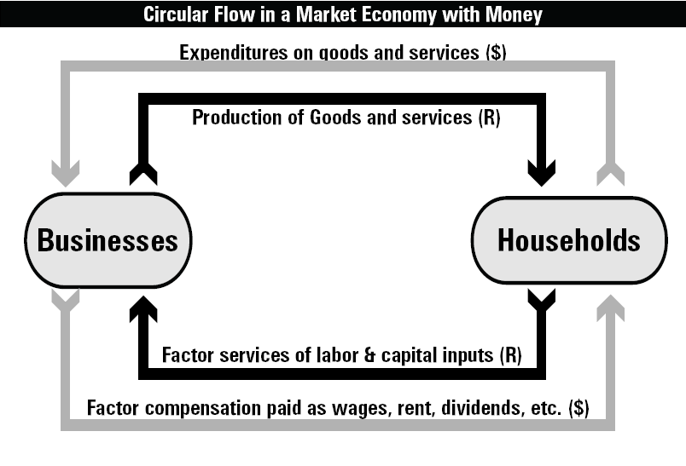

Circular Flow of Income
Notes:
This is economic activity, not necessarily economic growth

Slide 3
Growth vs. Activity
Difference between economic GROWTH and economic ACTIVITY
Stimulating economic activity is not the same as stimulating economic growth
Broken windows fallacy (transfer activity, not growth)
“Putting money in consumers pockets so they can spend”
Transferring money from one entity to another isn’t economic growth.
Borrowing from the future to spend now isn’t economic growth.

Slide 4
Current Services Budgeting
Government doesn’t budget like you do, like businesses do.
Federal spending increases on auto-pilot
Spending increases for population growth, inflation, salaries, other factories baked into the baseline
Any reduction from this growing baseline is a “cut.”

Slide 5
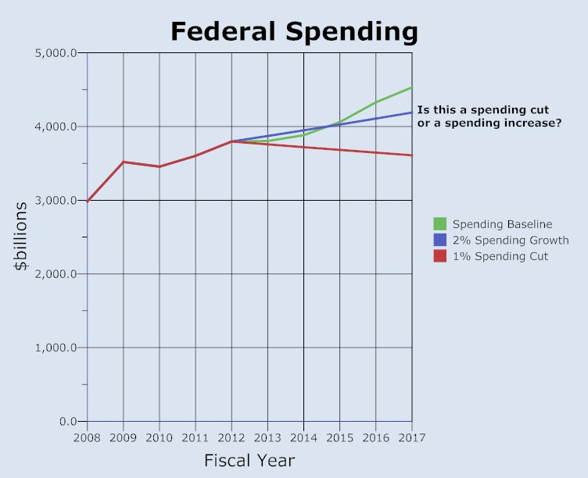

Slide 8
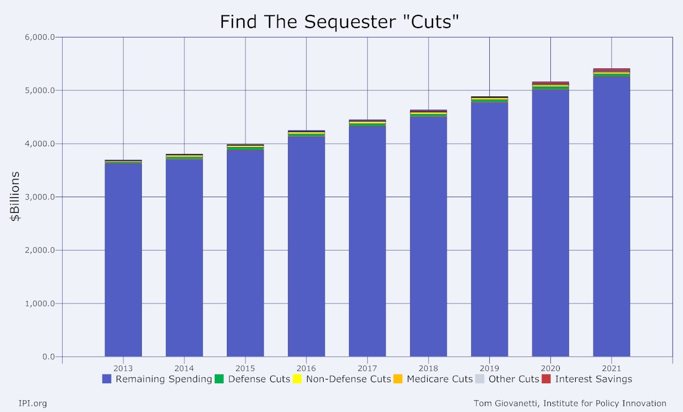

Slide 9
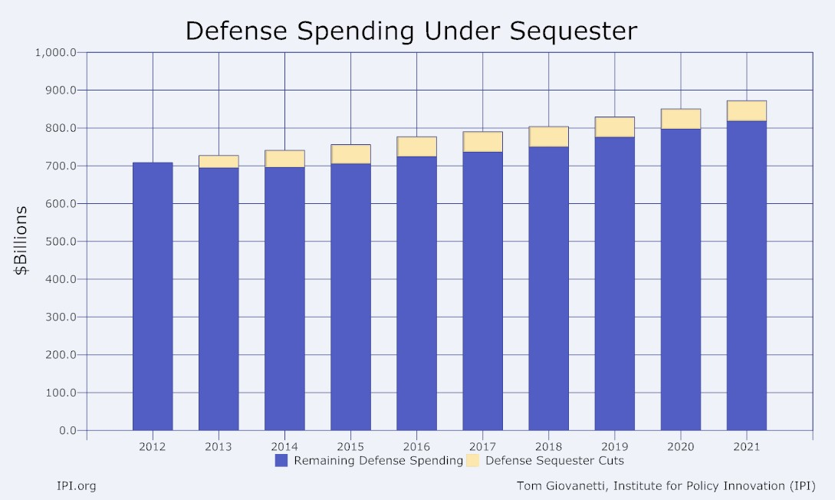

Slide 10
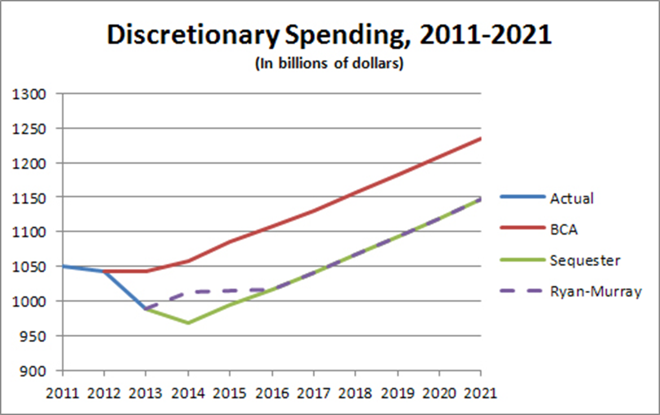
Impact of Budget Deal

Slide 11
Easy to Balance the Budget
Budget can be balanced by spending cuts alone.
BUT do we want a federal budget that is balanced but consumes 40% of GDP?
Balanced Big Government budget is not enough.
We need economic growth

