Slide 1
Tax Reform Principles & Proposals
Flat Tax
Vs.
FAIR Tax

Slide 2
Principles for Tax Reform
Neutrality – Tax code should not be used to manipulate behavior or distort consumer or business decisions. Create as few distortions as possible.
Simplicity – Because tax compliance is a deadweight loss to the economy.
Transparency – Taxes are the price we pay for government. If we want the citizens to be tax activists, they need to know the price they are paying for government. Price must not be masked by hidden taxes.

Slide 3
Easily Confused Concepts
Tax Collection Point: WHERE or HOW You’re Going to Collect the Tax
Tax Base: WHAT You’re Going to Tax

Slide 4
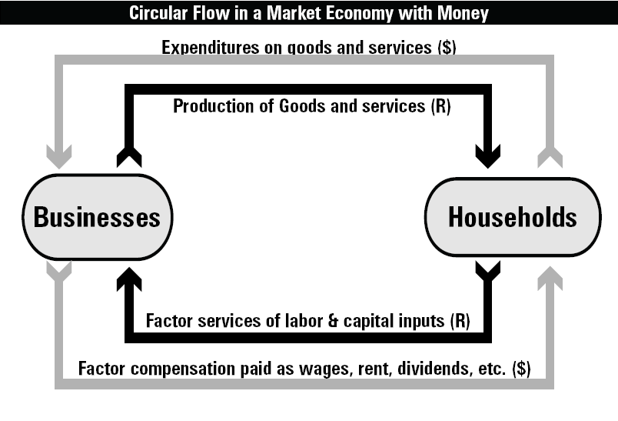

Circular Flow of Income
Notes:
This is economic activity, not necessarily economic growth

Slide 5
Tax Collection Points
Sales Tax
Collects Here
Corporate Income
Tax Collects Here
Personal Income Tax
Collects Here
Notes:
This is economic activity, not necessarily economic growth

Slide 6
Tax Base: What You Tax
Tax Base is composed of the economic production that is being taxed.
Tax Base has nothing to do with where the tax is collected (sales tax, income tax, etc.)
Example: Texas does not charge taxes on food purchased at grocery store, does not charge tax on services provided (architect, pest control, etc.)
Example: Federal gov’t does not charge income taxes on income from municipal bonds

Slide 7
Where Your Money Goes

Slide 8
If Savings Is Exempt from Taxes, Only Thing Taxed Is Consumption

Slide 9
Flat Tax Is a Consumption Tax, Not an Income Tax
Technically, the Flat Tax is a Consumed Income Tax
  Because it exempts the portion of your income that goes to savings,
  It taxes only the portion of your income that goes to consumption.
  Flat tax taxes consumption at the point of income, or when it is earned.

Slide 10
Huge Misunderstand in
Flat Tax vs. Fair Tax
People think they are radically different tax plans.
If you understand the distinctions I’ve made between tax bases and tax collection points, you can understand that:
  They have almost the same tax base
  They both meet the goals and tests of an improved tax system.
    Both tax production only once at a flat rate
    Both eliminate taxation of savings and investment
    Both would radically reduce but not eliminate the reach and power of the IRS

Slide 11
Huge Misunderstand in
Flat Tax vs. Fair Tax
Flat Tax and Fair Tax are almost identical in purpose and principle @ macroeconomic level
  Both tax all private sector production once and only once. Almost identical tax base.
  The only obvious difference between the two is the collection point.
    Flat tax collected “up front”
    Fair Tax collected later, when spent

Slide 12
Flat Tax vs. Fair Tax
Relative Differences
Either would be far better than what we have today.
Fair Tax is more politically difficult—requires repealing Sixteenth Amendment
Fair Tax is less transparent—or do YOU total up all your receipts every year?
Fair Tax rate is a bit dishonest—they call it 23%, but it’s actually 30%. If you have to pay a $30 tax on $100 worth of goods, that’s a 30 percent sales tax.

Slide 13
Fair Tax Receipt
1. Price before adding FT $ 100
2. FT 30
3. Total $ 130
4. FT Rate 23%
It won’t reveal that it derives the 23% by dividing the $30 FT by the $130 total
Notes:
See Section 509.

Slide 14
Flat Tax vs. Fair Tax
Relative Differences
Fair Tax seriously intrudes on the tax bases of states that rely on sales taxes (Hint: Texas!)
Fair Tax “prebate” opens doors to massive fraud.
Fair Tax political weakness: Appears to increase prices to consumers.
Flat Tax political weakness: “Trust Fund Babies” would not be taxed.

Slide 15
Flat Tax vs. Fair Tax
Relative Differences
Fair Tax does not really eliminate the IRS—there will always be a federal revenue agency. You can change its name, and you can limit its powers, but there will always be a federal revenue agency.
Most analysts agree that the Fair Tax’s 30% rate won’t work—no state has ever attempted such a broad base for a sales tax (groceries, etc.)
Fair Tax assumes zero tax avoidance, which isn’t realistic.
Fair Tax requires gov’t to pay sales tax on gov’t purchases. Otherwise, rate would be 40-50%.
What about people who have paid income taxes all their lives, and then when they retire, we switch to a sales tax? They would be double-taxed on their consumption.

