Slide 1
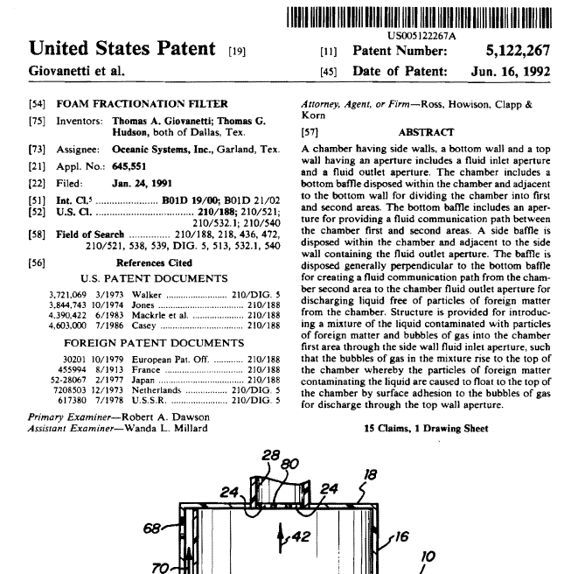

Slide 2
IPRs and Human Rights
Universal Declaration of Human Rights (1948)
“Everyone has the right to the protection and material interests resulting from any scientific, literary or artistic production of which he is the author.” (Article 27)

Slide 3
IPRs and Human Rights
American Declaration of Human Rights (1948)
“He likewise has the right to the protection of his moral and material interests as regards his inventions or any literary, scientific or artistic works of which he is the author.” (Article 13)

Slide 4
A “Narrow Set of Industries”

Slide 5
Value of U.S. Exports, 2012
57.7%
$891.9 bil.
U.S. Dept. of Commerce figures

Slide 6
Of COURSE Protecting IP Is In Our Self Interest!
Department of Commerce, “Intellectual Property and the U.S. Economy: Industries in Focus” (April 2012, based on 2010 data)
Entire U.S. economy relies on some form of IP
75 IP-intensive industries directly account for 27.1 million jobs, or 18.8% of all employment
IP-intensive industries indirectly support 12.9 million additional supply chain jobs
IP-intensive direct employment & supply chain = 40 million jobs or 27.7% of total employment
IP-intensive industries accounted for $5.06 trillion in value added, or 34.8% of US GDP
IP-intensive industries accounted for 60.7 percent of total U.S. merchandise exports.
NDP Analytics, “The Economic Benefits of Intellectual Property Rights in the Trans-Pacific Partnership” (December 2013)
Existing FTAs have boosted IP-intensive exports by 10.9 percent
Estimates TPP will increase manufacturing exports by $26 billion and create as many as 48,000 additional jobs, 2/3rds of which would be in IP-intensive industries
Estimates partner countries could see as much as $27 billion in additional sales and 68,240 new jobs.
Notes:
If so, I suggest you acquaint yourself with an excellent study conducted by the OECD in 2008. . . . This paper should be persuasive that strengthening IP rights should lead to increased foreign investment and tech transfer in countries that don’t have significant domestic IP generating capacity –yet. But even countries that don’t feel they have a domestic IP generating industry have something to gain from strong IP protection.

Slide 7
Stronger IPRs = Increased Foreign Direct Investment & Tech Transfer
OECD Trade Policy Working Paper No. 104, “Policy Complements to the Strengthening of IPRs in Developing Countries” (Gaurav Tiwari, 2012)
A 1 percent change in the strength of a country’s IP protection framework is associated with a 2.8 percent increase in FDI inflows and a 0.7 percent increase in domestic R&D.
OECD Trade Policy Working Paper No. 62, “Technology Transfer and the Economic Implications of the Strengthening of Intellectual Property Rights in Developing Countries” (Walter Park & Douglas Lippoldt, 2008)
“Intellectual property rights are a significant determinant of U.S. outward FDI” (foreign direct investment).
The results have established a positive association between patent rights and technology transfer, controlling for other variables, and that this association is not qualitatively different across different income groups of countries.”
“Thus stronger patent rights in developing countries have the potential not only to attract technology transfer but also encourage foreigners to transfer new technologies.”
Notes:
If so, I suggest you acquaint yourself with an excellent study conducted by the OECD in 2008. . . . This paper should be persuasive that strengthening IP rights should lead to increased foreign investment and tech transfer in countries that don’t have significant domestic IP generating capacity –yet. But even countries that don’t feel they have a domestic IP generating industry have something to gain from strong IP protection.

Slide 8
TRIPS Agreement Has Benefitted Signatories
“TRIPS at 20: Patenting, Public Health, and an Agreement That’s Working” (Edward Gresser, ProgressiveEconomy, 2013)
Post-TRIPS analysis
Research spending has grown relative to GDP.
OECD says R&D pre-TRIPS averaged 2.1 percent of GDP
Post-TRIPS, averaged 2.4 percent of GDP
Means an additional $200 billion committed to R&D—equal to combined spending of Germany and Japan
Pre-TRIPS there was no significant African movie industry. Post-TRIPS, in 2013, “Nollywood” produced as many films as India or America.
More, not fewer, medicines for developing countries. (IMS Health)
In 1990, developed countries accounted for 89 percent of spending on medicines
In 2005, developed countries accounted for 82 percent of spending on medicines
In 2011, developed countries accounted for 72 percent of spending on medicines
Notes:
If so, I suggest you acquaint yourself with an excellent study conducted by the OECD in 2008. . . . This paper should be persuasive that strengthening IP rights should lead to increased foreign investment and tech transfer in countries that don’t have significant domestic IP generating capacity –yet. But even countries that don’t feel they have a domestic IP generating industry have something to gain from strong IP protection.

